Slide 1

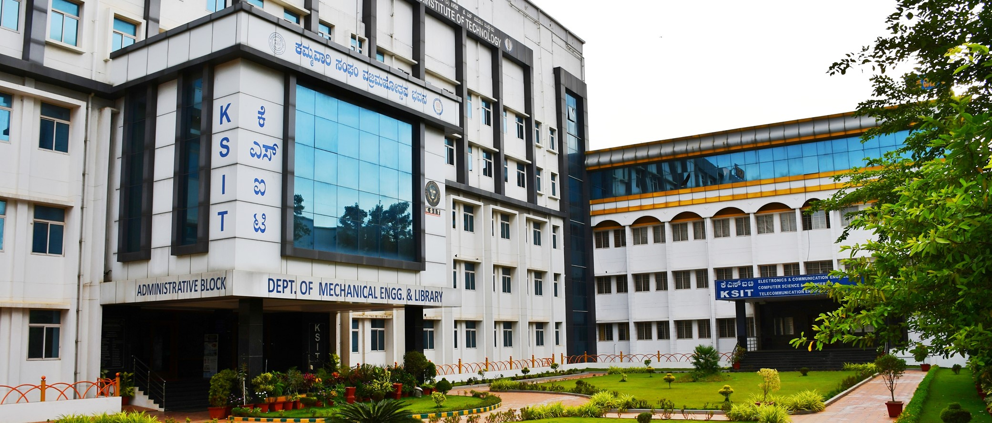
K. S. INSTITUTE OF TECHNOLOGY
#14, RAGHUVANAHALLI, KANAKAPURA ROAD,
BENGALURU – 560 109
WELCOMES THE CHAIRPERSON & MEMBERS OF
NBA TEAM – 10th , 11th and 12th December 2021

Slide 2
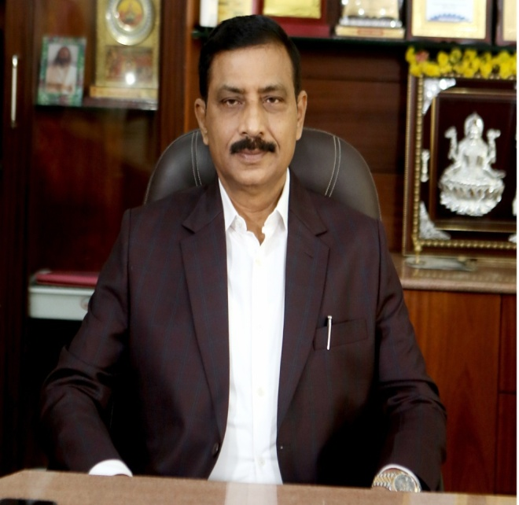
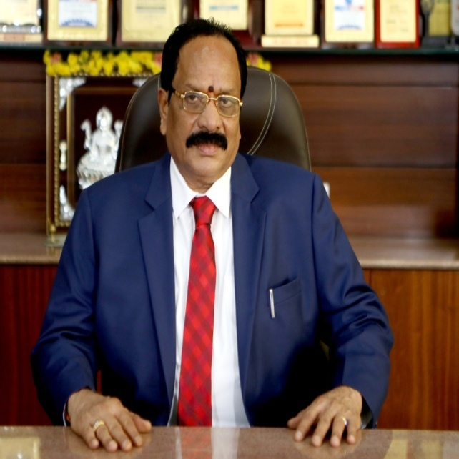
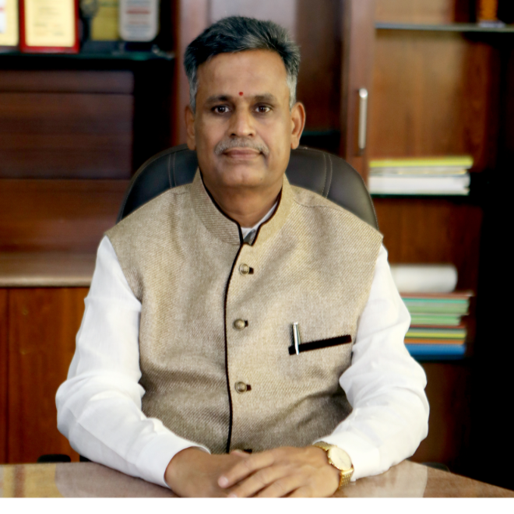
MANAGEMENT OF
KAMMAVARI SANGHAM
MANAGEMENT OF
KAMMAVARI SANGHAM
Sri. R.LEELA SHANKAR RAO
SECRETARY
Sri. R.RAJAGOPAL NAIDU
PRESIDENT
Sri. T.NEERAJAKSHULU NAIDU
TREASURER

Slide 3




ACTIVITIES OF KAMMAVARI SANGHAM
EDUCATIONAL
K. S. POLYTECHNIC
K. S. INSTITUTE OF TECHNOLOGY
K. S. SCHOOL OF ENGINEERING & MANAGEMENT.
K. S. SCHOOL OF ARCHITECTURE
HEALTH
K. S. HOSPITAL
CHARITY
K.S. HOSTEL
SOCIAL
K. S. KALYANA MANTAPA
KAMMA CREDIT CO-OPERATIVE SOCIETY

Slide 4






ACHIEVEMENTS/RECOGNITIONS
INSTITUTIONAL LEVEL
NAAC Accredited during 1st May 2019 with B++ for five years – Valid up to April 30th 2024.
'Band C' Institution
(Rank between 51-75)
Announced on
18 Aug 2020.
IEI Accreditation for
Electronics and Communication
Mechanical Engineering
Computer Science and Engineering
dated December 9th, 2016.
Best Student Chapter Award
2018
Selected as Mentor Institutions under the Mentor-Mentee Program 2021-22

Slide 5


ACHIEVEMENTS/RECOGNITIONS
INSTITUTIONAL LEVEL
State level CSI Student conventions in Year 2016
ROLE OF ICT TO MAKE DIGITAL INDIA & in Year 2020 through online platform with theme SELF RELIANCE AND AUTOMATION
21 Colleges and 266 Participants were in this event
State level Hackathon of 24 Hours
Sentinel Hack in the year 2018 (54 teams 189 Participants)
Sentinel Hack 2.0 in the year 2019 (72 Teams 256 Participants)
Hackathon - Incubate India and GitHub collaborated with KSIT in the year 2021
204 Participants

Slide 6
FACULTY ACHIEVEMENTS/RECOGNITION
Dr. P.N. Sudha
Professor & Head ECE
  Outstanding Woman in Engineering by Venus International Foundation, Chennai during 4th March 2017
Dr. M. Umashankar
Professor & Head ME
  Best Student Project Award
  from KSCST during 2018 and 2020
    Outstanding Professor award by word education congress in the year 2020
  3rd Prize in iSIGCSE Teaching COMPUTE’21 Challenge conducted by
  ACM India Special Interest Group on Computer Science education
Dr. Ram P Rustagi Professor
Dr. Dayananda R B
Professor
  Governor's National Award for Excellence in Research & Development
  during 2017-18
  Aditya Pai H
Assistant Professor
Best Paper Award in International conference held at SJCIT, Chikkaballapura on 17th and 18th May 2019 published in Elsevier

Slide 7






FACULTY ACHIEVEMENTS/RECOGNITION
Dr. B. Surekha
Professor
  Distinguished Woman Educator & Scholar Award by National Foundation for Entrepreneurship Development (NFED), Coimbatore during March 2018
  Senior Woman Educator and Scholar Award by National Foundation for Entrepreneurship Development (NFED), Coimbatore during March 2017
  Woman Achiever's Award by Institution of Engineers IE, Karnataka State Centre during March 2017
Mrs. Jayasudha B S K
Assistant Professor
  Best Researcher Award 2020 by IEEE Bangalore Section during Jan 2021
  Outstanding WIE Volunteer Award 2020 by IEEE Bangalore Section during Jan 2021
  Outstanding Small Student Branch Counselor by IEEE Bangalore Section during Jan 2020
  Best Volunteer Sliver Award by IEEE Women in Engineering during Aug 2019
Consultancy Services
    Dr Ram P Rustagi, Professor
    Dr Joy Prabhakaran , Professor

Slide 8




FACULTY ACHIEVEMENTS/RECOGNITION
Funds Received
      Dr Surekha Borra received Rs.3.0 Lakh
      VGST Sponsored Project
      Project Titled - Development of Bioinspired Algorithms for Real Time Piracy Detection Systems based on Thermo gram Analysis.
        Dr. Sangappa Received Rs 3.0 Lakhs for conduction of
        Three Refresher programs
        5G and its implementation Dec 2020
        Next Generation Wireless Communication-5G and Beyond May 2021
        Future Wireless Communication-Standards and Technologies May 2021.
      Dr. Aditya Pai received a grant of Rs.1.0 Lakh
      Warehouse Automation Using Drones
      EngiNX Tata Consultancy Services

Slide 9
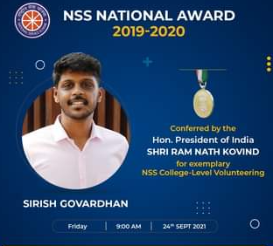
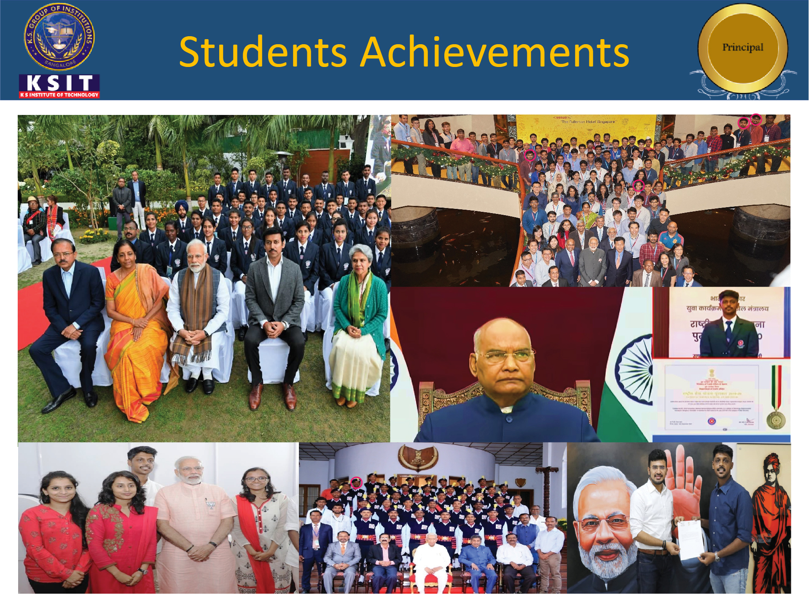

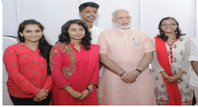
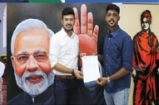
STUDENT LEVEL ACHIEVEMENTS/RECOGNITION
Mr. Sirish Govardhan
National award from Government of India and NSS State Award for the year 2019-2020 for his outstanding achievement in NSS
First Place in New Bengaluru for New India in the year 2018 met honorable Prime Minister of India Sri Narendra Modi
Felicitated by Mr. Tejasvi Surya, MP, Govt. of India, for taking part in a fundraising initiative titled –Tour de South India

Slide 10
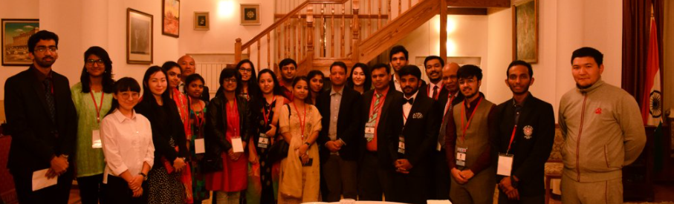
STUDENT LEVEL ACHIEVEMENTS/RECOGNITION
Mr. Vinay V. P. student of Mechanical Department participated in National Republic Day Parade Camp on 26th Jan 2019 in New Delhi
Mr. Vinay V. P. student of Mechanical Department participated in Indian Youth Delegation to Kyrgyzstan from 07th to 14th September, 2019.

Slide 11
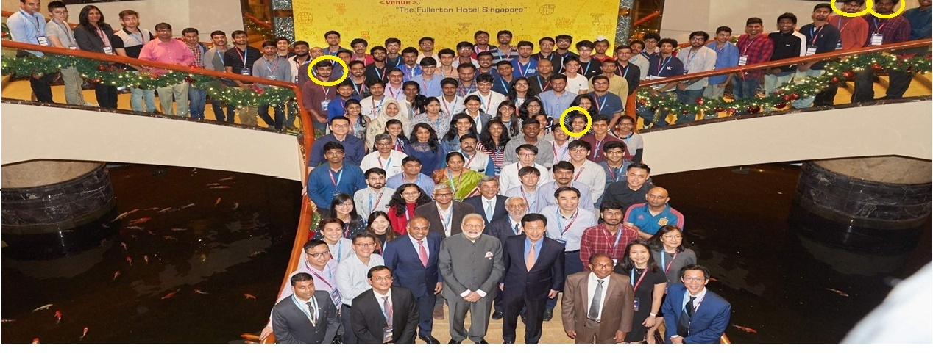


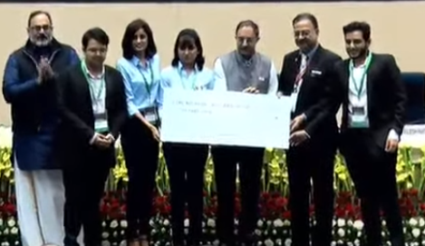


STUDENT LEVEL ACHIEVEMENTS/RECOGNITION
Abhishek M, Apoorva R, Aditya Kumar, Shrisha Mahuli of CSE participated in India-Singapore Hackathon-2018 held at
Nanyang Technological University (NTU), Singapore.
2nd Runner up
Team : Ctrl-Alt-Elite
Prize Money
1,00,000/-

Slide 12



STUDENT LEVEL ACHIEVEMENTS/RECOGNITION
KSIT
TEAMS IN
SIH
Smart India Hackathon(SIH) Central Government & AICTE
2017
“BIT- Hackers” Winner of SIH 2017 for Ministry of POST
2018
“ELECTRIC SHEEP” Winner of SIH- 2018 for Ministry Of Railways.
“ECHO 18” 1st Runner up of SIH- 2018 for Ministry of Telecom.
2019
“CRYPTIC_CODERS” Winner of SIH 2019 - for Ministry of Power
“PACMAN BYTES” Winner of SIH 2019 for Ministry of Civil Aviation
2020
[online] Contagious Intelligence –1. Winner @Meerut Nodal Center
[online] Contagious Intelligence –2 . Winner @TN Nodal Center
1,00,000/-
1st Runner up
75,000/-
Winner

Slide 13

STUDENT LEVEL ACHIEVEMENTS/RECOGNITION
Chaitra.R , 7th Rank (83.94%)
VTU Gold Medalist 8th Semester Topper
Maanasa Narayan 10th Rank (83.10%)
Abhishek M - Won 2nd Prize in Hackfest 2018 at SIT –Tumkur.
Sai Shashikaa, Vinay V. P. Sirish Govardhan and Team, – Won 1st Prize in “KUDIVA NEERIGOO GATI ILLA, JANARA BAVANEGE MITI ILLA” by Prime Minister of India.
Prabhu B and Team – Won 1st Prize in Competition- HAXPLOIT by SJBIT, Bengaluru.
Ketan Keshav got best IEEE Student Branch Execom Volunteer Award 2020

Slide 14
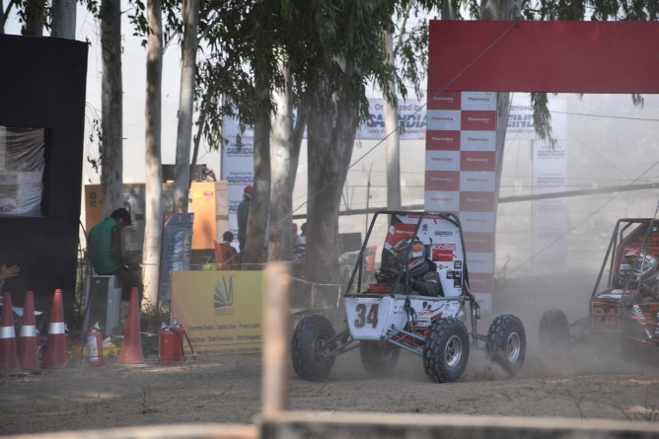
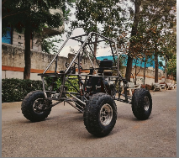
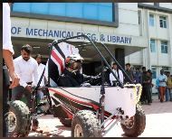
STUDENT LEVEL ACHIEVEMENTS/RECOGNITION
BAJA 2017 – MANJA
34 All India Ranking out of 433 teams
Karnataka Rankings in the Event. 7th in South India
BAJA 2018 DURJA
49 All India Ranking out of 472 teams.
MEGA ATV Championship 2018
Best Design Category Award
BAJA 2019 – ASKRAN
Overall: 15th All India Ranking with 2nd rank In Karnataka.
MEGA ATV Championship 2020-21 - ASKRAN 2.0
Overall: 9th All India Ranking with 1st rank In Karnataka.

Slide 15


EXTRA CURRICULAR ACTIVITIES
KSIT STUDENTS REPRESENTING KARNATAKA STATE
KSIT STUDENTS REPRESENTING VTU
Karnataka State Soft Ball
Priyanka S | CSE | Kabaddi
Karthik Narayan L | TCE | Swimming
Suhas Y | MECH | Swimming
Nischal.V.Chadaga | MECH | Softball
Rohith R | CSE | Softball
Shreyashwini V | ECE | Cricket
Priyanka S | CSE | Cricket
Sadhvika Chandra R | ECE | Cricket
Nischal.V.Chadaga | MECH | Baseball
Rohith R | CSE | Baseball
Prajwal Krishna | MECH | Cricket
Rohith R Dept of CSE
Prajwal Krishna Dept of Mech
Nischal.V.Chadaga Dept of Mech
Rohith K Dept of CSE
D. R. Uday Dept of ECE
Karnataka State Floorball
Vaishnav H Dept of Mech

Slide 16
EXTRA CURRICULAR ACTIVITIES
Sl. No | Name of the Students | Dept | Tournament/ Competition | Place | Level | Achievement
1 | Karthik Narayan L | TCE | VTU Inter College swimming competition 2018-19 | BMSCE Bengaluru3rd October 2018 | Inter-Collegiate | one silver medal & two bronze medal
2 | Suhas Y | MECH | VTU Inter College swimming competition 2018-19 | BMSCE Bengaluru3rd October 2018 | Inter-Collegiate | one bronze medal
3 | Karthik Narayan L | TCE | VTU Inter College swimming competition 2019-20 | Ramaiah IT Bengaluru 18th September 2019 | Inter-Collegiate | 2 silver & 2 Bronze Medal
4 | S Pechu Muthu | MECH | VTU Inter College Taekwondo competition 2019-20 | GAT Bangalore 17th October 2019 | Inter-Collegiate | One Bronze Medal

Slide 17
FACULTY CENTRIC POLICIES & UTILIZATION
Encouragement for Research.
Fee concession for wards of faculty and Staff.
Leave benefits to all the staff including study leave.
Sports facilities for staff and students.
Encouragement for attending FDPs, Seminars, Workshops and conferences.
Encouragement for pursuing online courses like NPTEL, Coursera, Swayam, etc.
Gratuity paid as per Gratuity Rules..
Marriage Leave.
Sick Leave – COVID leave.

Slide 18
FACULTY CENTRIC POLICIES & UTILIZATION
Recognition for Academic Achievements.
ICT enabled Classrooms.
Scope and encouragement for learning academic leadership skills.
Digital Library Access.
Encouragement for consultancy activities.
Motivation to publish research papers in reviewed journals

Slide 19
STUDENT CENTRIC POLICIES & UTILIZATION
Personal Mentoring.
Transport Facility.
Hostel Facility.
Multi Gym.
Central Library with Reading Room facility.
Canteen.
Reprographic facility.
Facility for Physically Challenged students –Lift, Ramp, Wheel Chair, Wash rooms, etc
Internet and WiFi facility, e-Resources,.
Placement and Training.
Career Guidance Services.
Value added Courses and Guest Lectures.
Scholarship worth 2.5 Crores every year.
University level sports and games.
Extra curricular and Co-curricular Activities.
Industrial visits and internship placements.
NSS and Outreach Activity through School Adoption.
Youth Red cross.
COVID 19 Vaccination Drive
Activities through Professional Bodies like IEEE, CSI, SAE, IEI, IIF, IETE, ISTE, BITES etc,.
Student Clubs - Firefox (CSE) - Gharuda (ECE)
- Emanation (ME)

Slide 20
QUALITY ASSURANCE INITIATIVE AND IMPACT
Accreditation Initiative – Planning, Data Collection and compilation, Execution, Monitoring and Maintenance.
IQAC Establishment
Timely academic and administrative activities
Modernization of Teaching –Learning Process with ICT Tools.
Transparency in Evaluation process
Establishment, maintenance and functioning of support structures.

Slide 21
ROLES OF IQAC
Establishment of Standards for Academic Processes.
Dissemination of Information among stakeholders about new methods.
Organizing Academic Activities like FDPs, Seminars, Workshops etc.
Establishment of Procedures for documenting academic and other activities.
Spearheading the Quality Initiatives and acting as a nodal agency for their implementation.
Preparation and timely submission of AQAR to various authorities.
Academic Audit.

Slide 22
INITIATIVE AND IMPACT OF IQAC
Preparation and circulation of various templates for collection and presentation of Information.
Organizing Academic Audit and communicating to stakeholders.
Consolidation of all the audit reports and presentation of the findings.
Conduction of IQAC Meetings at regular intervals and recommending the Quality Initiative for Implementation.
Improvements in all academic activities including, teaching learning, evaluation, project-work etc.,
Traceability of academic activities have improved.
Many systems governing activities have been properly streamlined thereby increasing their efficiency.

Slide 23
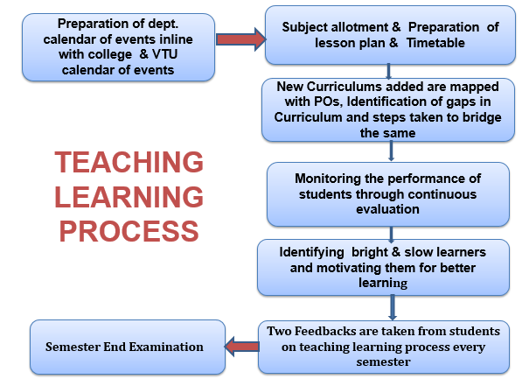
TEACHING LEARNING PROCESS

Slide 24
DIMENSIONS OF TEACHING LEARNING
Academic Planning & Implementation
Skill Development & Training
TEACHING- LEARNING PROCESS
Experiential Learning
Mentoring & Facilitating

Slide 25
ELECTRONICS & COMMUNICATION ENGINEERING FACULTY TEAM
Sl. No | Staff Name | Qualification | Designation
1 | Dr. P.N Sudha | M.Tech, Ph.D | Professor & Head, ECE
2 | Dr. B Surekha | M.Tech, Ph.D | Professor
3 | Dr. Sangappa.S.B | M.E, Ph.D | Professor
4 | Dr. P Joy Prabhakaran | M.S, Ph.D | Professor
5 | Dr. Chanda V Reddy | M.Tech, Ph.D | Professor
6 | Dr. B.Sudharshan | M.Tech, Ph.D | Professor
7 | Dr. Rekha N | M.Tech, Ph.D | Associate Professor
8 | Dr. Dinesh Kumar D S | M.Tech, Ph.D | Associate Professor
9 | Dr. Devika B | M.Tech, Ph.D | Associate Professor
10 | Mr. B.R.Santhosh Kumar | M.Tech, (Ph.D) | Associate Professor
11 | Mrs. Ramya K R | M.Tech, (Ph.D) | Associate Professor
12 | Mrs. Vishalini Divakar | M.Sc. Engg., (Ph.D) | Asst professor
13 | Mrs. Jayasudha B.S.K | M.Tech, (Ph.D) | Asst professor

Slide 26
ELECTRONICS & COMMUNICATION ENGINEERING FACULTY TEAM
Sl. No | Staff Name | Qualification | Designation
14 | Mr. Sampath Kumar. S | M.Tech, (Ph.D) | Asst professor
15 | Mr. Sunil Kumar.G.R | M.Tech, (Ph.D) | Asst professor
16 | Mrs.Sangeetha.V | M.E, (Ph.D) | Asst professor
17 | Mr. Praveen.A | M.Tech, (Ph.D) | Asst professor
18 | Mr. Christo Jain | M.E, (Ph.D) | Asst professor
19 | Mr. Saleem S Tevaramani | M.E, (Ph.D) | Asst professor
20 | Mrs. Pragati. P | M.Tech, (Ph.D) | Asst professor
21 | Mrs. Aruna Rao B.P | M.Tech, (Ph.D) | Asst professor
22 | Mr. Satish Kumar B | M.Tech. | Asst professor
23 | Mrs. Pooja S | M.Tech, (Ph.D) | Asst professor
24 | Mr. Dileep J | M.Tech, (Ph.D) | Asst professor
25 | Mrs. Bhargavi Ananth | M.Tech. | Asst professor
26 | Mrs. Mohanambica K.M | M.Tech. | Asst professor

Slide 27
COMPUTER SCIENCE AND ENGINEERING
FACULTY TEAM
Sl. No | Staff Name | Qualification | Designation
1 | Dr. Rekha.B.Venkatapur | M.Tech, Ph.D | Professor and Head, CSE
2 | Dr. Dayananda.R.B | M.Tech, Ph.D | Professor
3 | Dr. K.Venkata Rao | M.Tech, Ph.D | Professor
4 | Mr. Harshavardhan. J. R | M.Tech | Associate Professor
5 | Dr. Deepa.S.R | M.Tech, Ph.D | Associate Professor
6 | Dr.Vaneeta.M | M.Tech, Ph.D | Associate Professor
7 | Dr Vijayalaxmi.M | M.Tech, Ph.D | Associate Professor
8 | Mrs.Sougandhika Narayan | M.Tech. | Asst professor
9 | Mr. Sanjoy Das | M.Tech. | Asst professor
10 | Mr. RoopeshKumar.B.N | M.Tech. | Asst professor
11 | Mr. Kushal Kumar.B.N | M.Tech.(Ph.D) | Asst professor
12 | Mr. Kumar.K | M.Tech. | Asst professor

Slide 28
COMPUTER SCIENCE AND ENGINEERING
FACULTY TEAM
Sl. No | Staff Name | Qualification | Designation
13 | Mr. Raghavendrachar.S | M.Tech.(Ph.D) | Asst professor
14 | Dr. Swathi. K | M.Tech, Ph.D | Asst professor
15 | Mr. Krishna Gudi | M.Tech.(Ph.D) | Asst professor
16 | Mr. Prasahanth H S | M.Tech. | Asst professor
17 | Mrs. Beena.K | M.Tech. | Asst professor
18 | Mr. Chillara Anil Kumar | M.Tech.,(Ph.D) | Asst professor
19 | Mrs. Swapna Gopal Jois | M.Tech. | Asst professor
20 | Mr. Manoj Kumar S | M.Tech. | Asst professor
21 | Mrs. Geetha R | M.Tech. | Asst professor
22 | Mrs. Pallavi K N | M.Tech. | Asst professor
23 | Mrs. R. S Geethanjali | M.Tech. | Asst professor
24 | Mrs. Dakshayiani G. R | M.Tech. | Asst professor

Slide 29
MECHANICAL ENGINEERING
FACULTY TEAM
Sl. No | Staff Name | Qualification | Designation
1 | Dr. Umashankar. M | M.Sc ENGG., Ph.D | Professor & Head, ME
2 | Dr. K. V. A. Balaji | M.E, Ph.D | Professor & CEO
3 | Dr. Dilip Kumar K | M.Tech, Ph.D | Principal / Director
4 | Mr. M. Nagabhushana | M.E, (Ph.D) | Associate Professor
5 | Mr. K. Prasad | M.Tech, (Ph.D) | Associate Professor
6 | Dr. Nagaprasad .K.S | M.Tech, Ph.D PGDOM | Associate Professor
7 | Dr. Girish .T.R | M.Tech, Ph.D | Associate Professor
8 | Dr. L. Nirmala | M.Sc ENGG. Ph.D | Associate Professor
9 | Mr. Abhishek M. R | M.Tech | Associate Professor
10 | Mr. Manjunath .B.R | M.Tech, (Ph.D) | Asst professor
11 | Mr. Ranganath .N | M.Tech, (Ph.D) | Asst professor
12 | Mr. Anil Kumar A | M.Tech, (Ph.D) | Asst professor

Slide 30
MECHANICAL ENGINEERING
FACULTY TEAM
Sl. No | Staff Name | Qualification | Designation
13 | Mr. Harish .U | M.E, (Ph.D) | Asst professor
14 | Mr. Parashuram .A.K | M.Tech, (Ph.D) | Asst professor
15 | Ms. TejaswinI M.L. | M. Tech | Asst professor
16 | Dr. Saleem Khan | M.Tech, Ph.D | Asst professor
17 | Mr. Rajesh G L | M.Tech, (Ph.D) | Asst professor
18 | Mr. Trimurthy | M.A, M.Ed | Asst professor
19 | Mr. Harsha J | M.Tech | Asst professor

Slide 31
FACULTY CONTRIBUTION
FACULTY PUBLICATIONS
Details | 2020-21 | 2019-20 | 2018-19 | 2017-18
Publication | 123 | 70 | 81 | 56
Patents Filed/Obtained | 07 | 04 | -- | 02
RESEARCH GRANTS RECEIVED IN LAKHS
Details | VGST | KSCST | VTU | Consultancy | OTHERS
ECE | 8.0 | 0.28 | 0.30 | 54.75 | --
CS&E | 20.0 | 0.31 | 0.30 | 16.51 | 4.15
MECH | 6.0 | 0.64 | 0.10 | -- | --

Slide 32
STUDENT PERFORMANCE POINTS
Enrollment Ratio in Percentage
Program /Year | 2020-21 | 2019-20 | 2018-19 | 2017-18 | Average
ECE | 66.0 | 90.0 | 90.0 | 86.7 | 82.0/88.9
CS&E | 95.0 | 95.0 | 100.0 | 84.0 | 96.7/93.0
MECH | 13.33 | 32.5 | 66.6 | 81.7 | 37.47/60.3
Student-Faculty Ratio (SFR)
Program /Year | 2020-21 | 2019-20 | 2018-19 | 2017-18 | Average
ECE | 24.58 | 19.82 | 22.48 | 24.7 | 22.29/22.33
CS&E | 19.90 | 19.41 | 18.87 | 25.17 | 19.39/21.15
MECH | 28.14 | 22.95 | 23.22 | 25.33 | 24.77/23.83

Slide 33
SUCCESS INDEX
Success Index without Backlogs in %
Program/ Output Year | 2019-20 | 2018-19 | 2017-18 | Average
ECE | 44.0 | 43.0 | 44.0 | 43.7
CSE | 51.0 | 49.0 | 42.0 | 47.0
MECH | 23.0 | 21.0 | 28.0 | 24.1
Success Index with & without Backlogs in %
Program/ Output Year | 2019-20 | 2018-19 | 2017-18 | Average
ECE | 76.0 | 70.0 | 97.0 | 81.0
CSE | 81.0 | 80.0 | 69.0 | 77.0
MECH | 71.0 | 66.0 | 62.0 | 66.3

Slide 34
PLACEMENT INDEX
Program /Year | 2019-20 |  |  |  |  | 2018-19 |  |  |  |  | 2017-18
 | NS | P | H | E | PI | NS | P | H | E | PI | NS | P | H | E | PI
ECE | 100 | 73 | 3 | 0 | 0.76 | 118 | 85 | 7 | 1 | 0.79 | 109 | 67 | 12 | 2 | 0.74
CSE | 110 | 87 | 3 | 1 | 0.83 | 117 | 76 | 5 | 1 | 0.7 | 115 | 57 | 7 | 0 | 0.56
MECH | 104 | 54 | - | - | 0.52 | 127 | 34 | 6 | - | 0.31 | 139 | 34 | 6 | 1 | 0.29
NS – Number of Students
H – Higher Studies E – Entrepreneurs
PI – Placement Index P - Placed

Slide 35
FACILITIES AND TECHNICAL SUPPORT
Conference Hall with a seating capacity of 200.
Campus-wide LAN and Wi-Fi facilities.
Bus Facility for students and staff augmented by METRO Network.
Friendly to Differently Abled Staff and Students.
Stationery / Reprographic stores.
Spacious Canteen.
Separate well equipped hostels for Boys and Girls.
First Aid Room Facility with Ambulance.
Well Equipped Ladies Common Room and Students Common Area.
Highly supportive Placement and Training Centre.
Strong one to one Mentoring System.
Well Equipped Seminar Hall for Each Department.

Slide 36
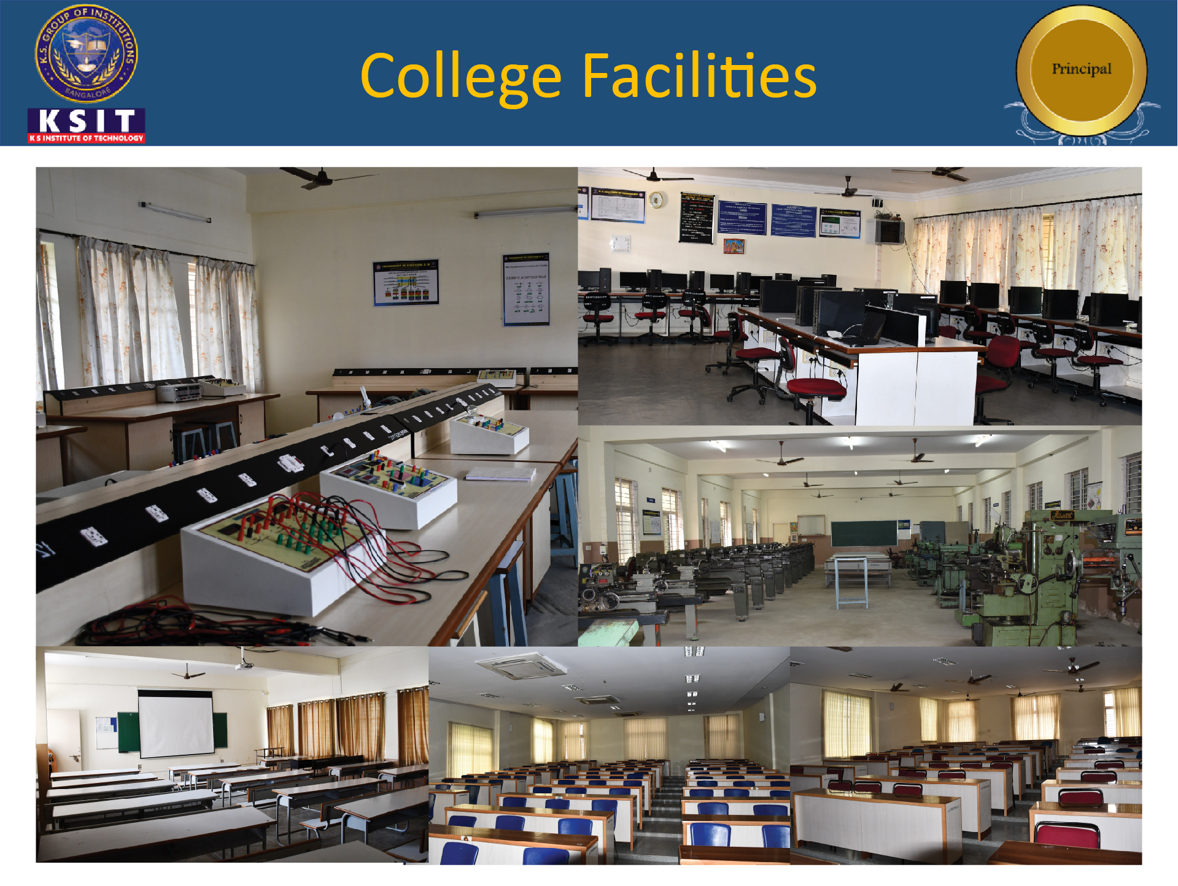
COLLEGE FACILITIES

Slide 37
COMPUTATIONAL FACILITIES
Sl.No. | Description | Number
1 | Desk Tops | 715
2 | Servers | 02
3 | Legal Softwares | 52
4 | Printers | 41
5 | LCD Projectors | 42
6 | Wi-Fi Access Points | 32
7 | UPS | 12 (295KVA)
8 | Internet Band Width | 500Mbps
9 | Back up Supply (Generators) | 250 KVA
10 | Closed Circuit TV Cameras | 99
11 | Storage Device | 02
12 | Fire Wall | 01
13 | Laptops | 05
14 | Scanners | 05

Slide 38
LIBRARY
Description | Requirement | Available
Number of Titles | 4975 | 5000
Number of Volumes | 35500 | 35829
Seating capacity in Sq.M. | 150 | 200
Area of Library in Sq.M. | 400 | 950
Library Software | Desirable | Available, Libsoft 9.8 Version
NDL Membership | Desirable | Available
DELNET Membership | Desirable | Available
Tech Focus Digital Library | 10 Multimedia PCs | 18 Multimedia PCs
Library Books are Classified as per DEWEY DECIMAL CLASSIFICATION

Slide 39
VTU LIBRARY CONSORTIUM DETAILS
SL No. | Publisher | Total No. of E-Resources
1. | Elsevier | 296 Journals
2. | IEEE Proceedings Order Plan (POP) | 530,000 papers - from 100 core IEEE conference titles in POP
3. | Springer Nature | 690 Journals
4. | Taylor & Francis | 555 Journals
5. | Emerald | 120 Journals
6. | Pro-Quest | Full text: 3900 Journals Indexed: 7800 Abstract
7. | Springer Nature (Perpetual Access from 2014) | 12,125 E-Books
8. | Taylor & Francis (Perpetual Access from 2019-20) | 4,950 E-Books
9. | Elsevier (Perpetual Access from 2019-20) | 436 E-Books
10. | Mc-Graw Hill (Four Years Subscription from 2019-20) | 505 E-Books
11. | New Age International (Perpetual Access from 2019-20) | 220 E-Books
12. | Packt (Perpetual Access from 2019-20) | 5002 E-Books
13. | Knimbus | E-Books: 10,000+ E-Journals: 5700+
14. | Turnitin | Plagiarism Originality Online Check
15. | NetAnalytiks | LANQUILL (Writing Grammar Tool)

Slide 40
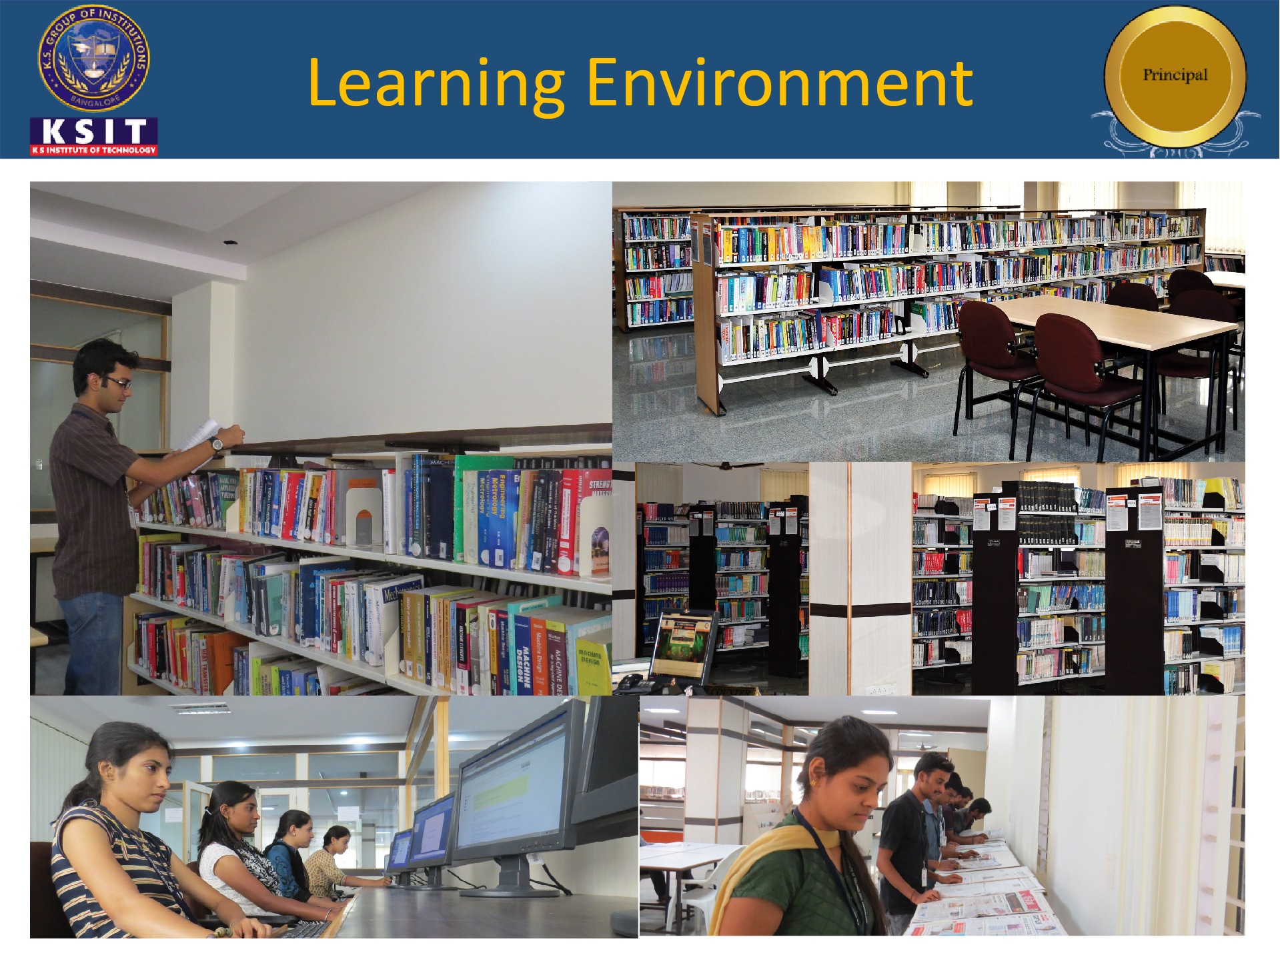
LEARNING ENVIRONMENT

Slide 41
GOVERNANCE
Management Committee KSGI
Governing Council
Academic Advisory Board
Management KSIT
Principal
and
Heads of Department

Slide 42
MEMBERS OF THE
MANAGEMENT COMMITTEE
Sri R.Rajagopal Naidu Hon.President of KSGI,
Dr. M. Rukmangadha Naidu Vice President, KSGI
Sri B. Lokanadha Naidu Vice President KSGI,
Sri R.Leelashankar Rao Hon.Secretary KSGI
Sri V.Rajendra Naidu Joint Secretary, KSGI
Sri S.Venugopal Naidu Joint Secretary, KSGI
Sri T. Neerajakshulu Naidu Treasurer, KSGI
Sri M. Yogamurthy Internal Auditor, KSGI,
Sri M Sudhakar Chairman Legal Cell,
Sri N.M.Krishnamurthy Chairman, Finance Committee, KSGI,
Sri A.V.Nagaraj Chairman, Building Committee, KSGI,
Sri N Krishnama Naidu Chairman, Hostel Committee, KSGI
Sri D.Jagadish Kumar Chairman, Transport Committee, KSGI
Sri T.N.Manjunath Chairman, Environment Committee, KSGI
Sri G.Ramana Babu Director, KSGI
Sri G.V. Ramesh Director, KSGI,
Sri V. Ramesh Kumar Director, KSGI,
Sri J.M.Chandrashekar Director, KSGI,
Sri P.Prabhakar Naidu Director, KSGI,

Slide 43
MEMBERS OF THE
GOVERNING COUNCIL
Name | Designation | Name | Designation
Sri R. Rajagopal Naidu President, KSGI | Chairman | Dr. T. M. Naidu Ex- DRDO, | Member
Sri. K. Subramanya Naidu Hon.Past President, | Member | Dr. Manjunath. B. Principal, New Horizon College of Engineering VTU Nominee. | Member
Dr. M Rukmangadha Naidu Hon.Vice Presdent, KSGI, | Member | DTE (Ex-Officio) | Member
Sri K. Venkatesh Naidu Former Hon.Secretary, KSGI | Member | Prof. Ranganath Principal and Director, Adi Amman College of Engineering Hosur | Member
Sri. R.Leela Shankar Rao Hon.Secretary, KSGI | Member | Sri Vishwanatham Peddi Program Director, Mindtree | Member
Sri T.Neerajakshulu Naidu Hon.Treasurer, KSGI | Member | Dr. K. Dilip Kumar Principal and Director, KSIT | Member Secretary
Regional Officer (EX-Officio) AICTE | Member | Dr. K.V.A. Balaji CEO, KSGI | Special Invitee

Slide 44
ACADEMIC ADVISORY BOARD
Name | Designation | Background
Prof. H. P. Khincha | Chairman | Former Vice Chancellor, VTU, Professor, IISc
Prof. K. N. Balasubramanya Murthy | Member | Vice Chancellor, DSU,
Prof. Y. N. Srikanth | Member | Former Professor, IISc,
Dr. Shyam Vasudeva Rao | Member | Industrialist
Dr. K.V.A. Balaji | Member Secretary | Former Registrar, VTU,

Slide 45
ORGANIZATION STRUCTURE
MANAGEMENT
ACADEMIC ADVISORY
BOARD
CHIEF EXECUTIVE OFFICER
PRINCIPAL/DIRECTOR
HEAD OF THE
DEPARTMENT
CHIEF
LIBRARIAN
PLACEMENT AND TRAINING
PUBLIC RELATIONSHIP
OFFICER
SENIOR
MANAGER
HOSTEL
WARDEN
TRANSPORT
INCHARGE
PED
LIBRARY
ASSISTANTS
P &T
ASSISTANTS
DRIVERS
TEACHING
FACULTY
NON TEACHING
FACULTY
ACCOUNT
SECTIONS
EXAM SECTIONS
ESTABLISHMENT
SECTIONS

Slide 46
RESOURCE MOBILIZATION
SOURCES | UTILIZATION
Tuition fee Bus fee Bank interest - SB & FD Hostel fee | Salaries , EPF, ESI, staff welfare fund Electricity charges, repairs and maintenance Institution advertisement, telephone charge, postage and telegrams, news paper and Periodicals Lab consumables, professional charges, university and other fee, meeting expenses Transport and travelling expenses Sports and Games Building and garden maintenance Printing and stationary, internet charges, UPS maintenance

Slide 47
ADEQUACY OF BUDGET ALLOCATION
Financial year | Requested budget (in Lakhs) | Approved budget (in Lakhs) | Adequate / Not Adequate
2020-21 | 1437.98 | 1200.00 | Adequate
2019-20 | 1429.27 | 1400.00 | Adequate
2018-19 | 1649.41 | 1600.00 | Adequate
2017-18 | 1556.57 | 1550.00 | Adequate
2016-17 | 1630.71 | 1600.00 | Adequate

Slide 48
BUDGET ALLOCATION, UTILIZATION, AND PUBLIC ACCOUNTING AT INSTITUTE LEVEL
(IN LAKHS)
Items | Budget in 2020-2021 | Actual Expenses in 2020-2021 | Budget in 2019-2020 | Actual Expenses in 2019-2020 | Budget in 2018-2019 | Actual Expenses in 2018-2019 | Budget in 2017-2018 | Actual Expenses in 8 2017-2018
Infrastructure Built-Up | 2.85 | 0.385 | 5.0 | 131.5 | 400.60 | 349.82 | 300.3 | 440.05
Library | 13.7 | 12.01 | 13.80 | 12.54 | 14.0 | 12.60 | 13.2 | 11.64
Laboratory equipment | 62.57 | 8.81 | 74.40 | 12.21 | 63.38 | 37.06 | 62.65 | 46.26
Laboratory consumables | 5.51 | 4.08 | 3.75 | 7.9 | 3.98 | 8.06 | 2.565 | 4.20
Teaching and non-teaching staff salary | 950 | 769.90 | 936.0 | 853.7 | 836.00 | 847.32 | 836. | 749.1
Maintenance and spares | 25.43 | 22.95 | 41.76 | 36.65 | 14.4 | 48.86 | 28.48 | 17.76
R&D | 2.02 | 0.53 | 5.0 | 2.23 | 5.0 | 5.67 | 5.0 | 2.97
Training and Travel | 22.23 | 8.8 | 30.26 | 24.68 | 38.65 | 31.97 | 22.895 | 13.47
Miscellaneous expenses * | 233.02 | 36.35 | 179.80 | 62.81 | 142.45 | 69.31 | 139.54 | 72.89
Others | 120.65 | 117.83 | 139.51 | 139.70 | 130.95 | 103.04 | 145.95 | 124.94
Total | 1437.9 | 981.75 | 1429.27 | 1284.05 | 1649.41 | 1513.72 | 1556.57 | 1483.35

Slide 49
UTILIZATION OF ALLOCATED FUNDS
Financial year | Approved budget (in Lakhs) | Actual expenditure (in Lakhs) | Percentage of utilization
2020-21 | 1200 | 981.75 | 81.8%
2019-20 | 1400.00 | 1284.05 | 91.71%
2018-19 | 1600.00 | 1513.7 | 94.61%
2017-18 | 1550.00 | 1483.35 | 95.7%
2016-17 | 1600.00 | 1553.51 | 94.59%

Slide 50



INSTITUTE VISION & MISSION
 | To impart quality technical education with ethical values, employable skills and research to achieve excellence.
 | M1: To attract and retain highly qualified, experienced and committed faculty. M2: To create relevant infrastructure. M3: Network with industry and premier institutions to encourage emergence of new ideas by providing research and development facilities to strive for academic excellence. M4: To inculcate the professional and ethical values among young students with employable skills and knowledge acquired to transform the society.

Slide 51
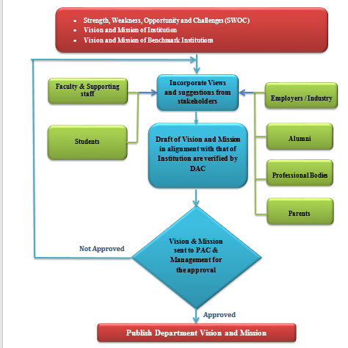
PROCESS DETAILS FOR FRAMING
VISION & MISSION

Slide 52
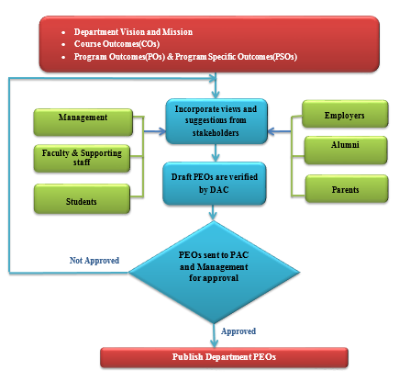
PROCESS FOR FRAMING PEO’S

Slide 53

GREEN INITIATIVE

Slide 54
THANK YOU

