Slide 1


HEARTY WELCOME
TO
NBA EXPERT COMMITTEE MEMBERS
DEPARTMENT OF MECHANICAL ENGINEERING
Presented by
Dr. Umashankar M
HOD ME

Slide 2
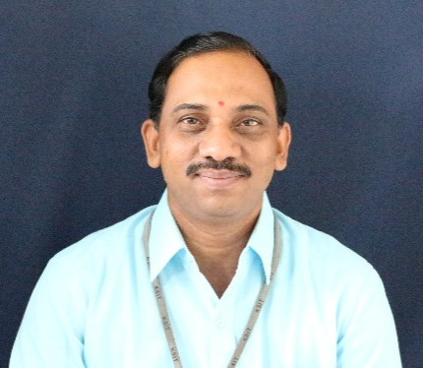
Head of the Department
Dr. Umashankar M _{M.Sc (ENGG), PhD, MIE, MISTE}
Professor & Head
Department of Mechanical Engineering
Education: B.E. – M. S. R. I. T., Bangalore University – 1996 M.Sc (ENGG). – U.V.C.E., Bangalore University-2006 Ph.D. – V.I.T., Chennai - 2021 | Experience: Teaching Experience – 20 Years Research Experience – 8 Years
Professional Body Membership: The Institution of Engineers [India] (IEI) Indian Society for Technical Education (ISTE) | Publications: International Journals – 6 International Conferences – 2 National Conferences- 1

Slide 3

Inception & Programs offered in ME Dept
Year of Inception of ME department : 1999
Sanctioned Intake in year 1999 : 60
1st Upgradation in intake was in the year 2004 : 90
2nd Upgradation in intake was in the year 2009 : 120
Present Sanctioned in the year 2021: 60
Programs offered in ME department
Under graduation [UG]
Post Graduation [PG]
PhD

Slide 4

Introduction
Faculty – Infrastructure - Students
Female Faculty – 02
Male Faculty - 17
10
Laboratories
37.49%
Enrolment Ratio (In last three years)
19
Professors
7
Class Rooms
Enrolment Ratio (when dept. APPLIED for NBA)
3
60.28%
Department Library
Avg. Pass % in last three years
Associate Professors
1
66.34%
6
Assistant Professors
2
Seminar Hall
51%
Placements
10
1
R & D Center
21
Online certification courses
Ph.D Holders
7
1
HOD Office
8
Total Number of VTU Ranks from inception
Faculty Pursuing Ph.D
9
20
Faculty Cabins
4
Professional bodies– IEI, ISTE, IIF, SAE
Paper Publications
48
500 Mbps
Internet

Slide 5

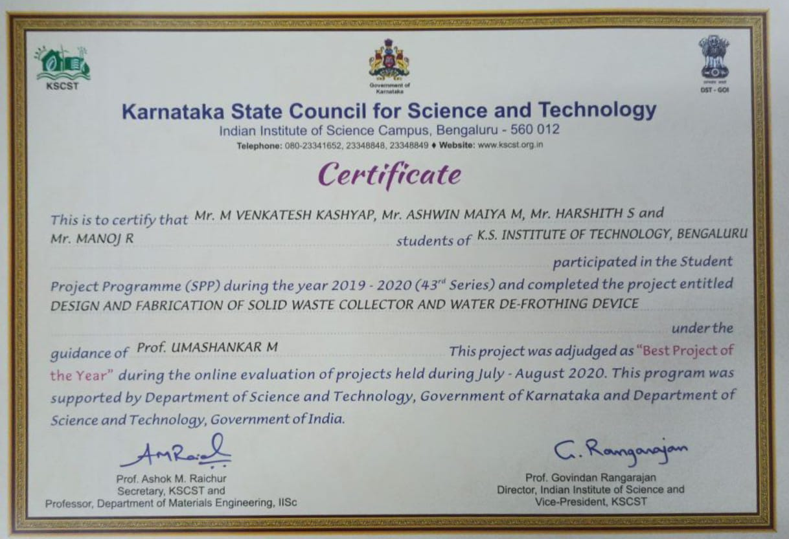
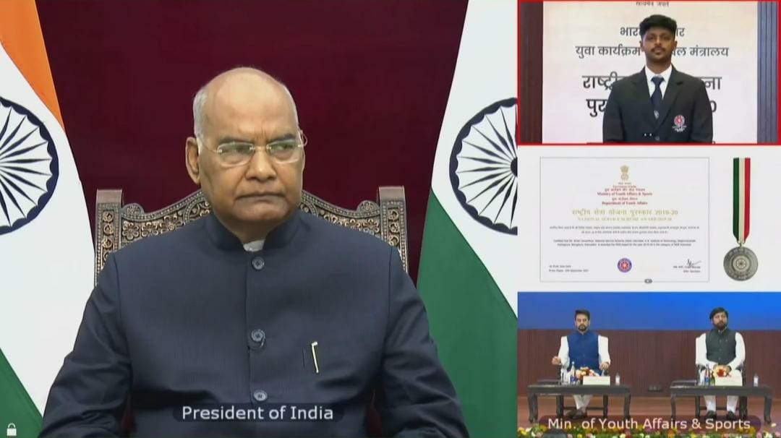
Departmental Achievements & Recognition
State NSS Award 2020-21
KSCST Award for Best Project,2019-20

Slide 6
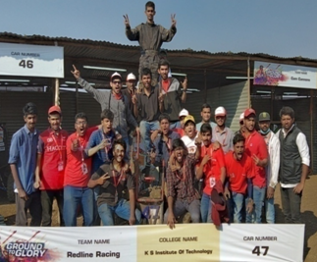
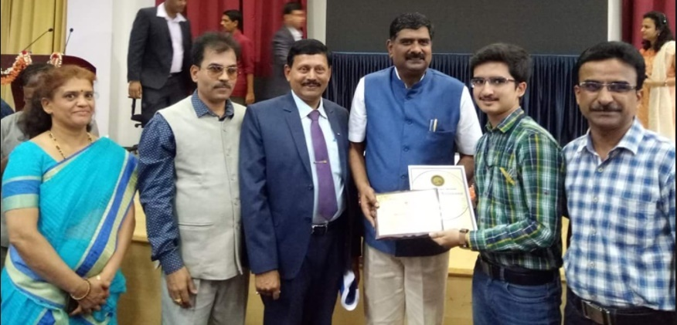
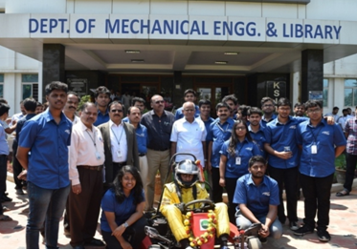
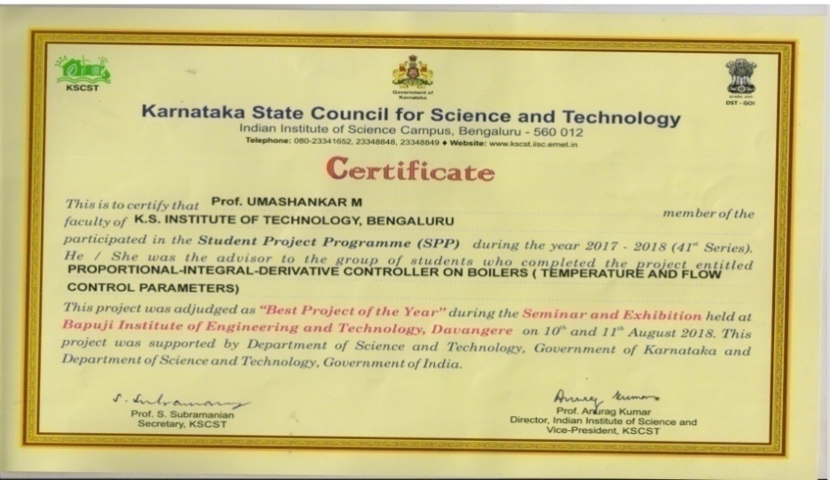
Departmental Achievements & Recognition
Our BAJA Team, 2018-19
Best Student Award by ISTE, 2017-18
Our Gokart Team, 2017-18
KSCST Award for Best Project, 2017-18

Slide 7
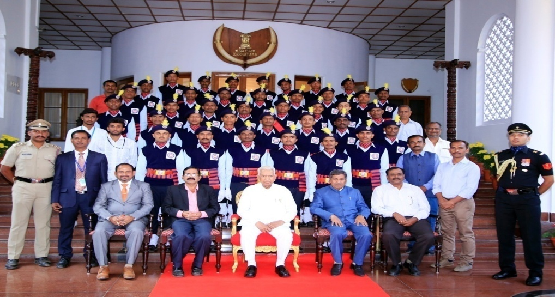
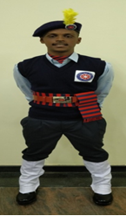
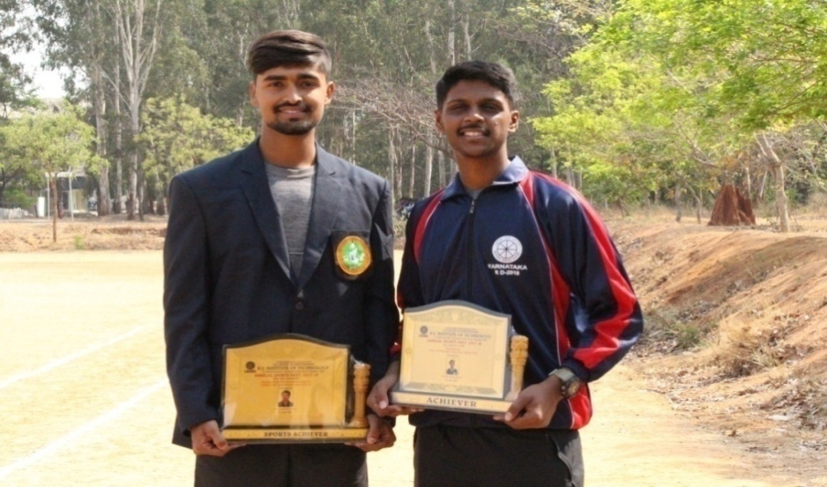
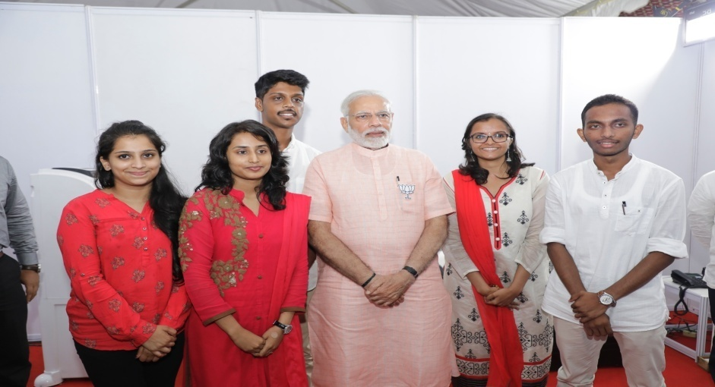
Departmental Achievements & Recognition
Participation in the Republic Day Parade, 2018
Best Sportsman and Best NSS Volunteer, 2018
Our Students with the Hon.Prime Minister in 2018

Slide 8
Faculty Awards
Sl. No. | Name of the Awardee | Name of the Award | Name of the Awarding Agency | Year of Award
1 | Mr. Umashankar M | Best Student Project Award | KSCST | 2020
2 | Mr. Umashankar M | Best Student Project Award | KSCST | 2018
3 | Mr. Nagaprasad K S | Young Scientist Award | VGST | 2013
4 | Mr. K. Prasad | Project of the Year | KSCST | 2013

Slide 9



Criteria-1
Institute & Department Vision, Mission
 | Institute | Department
 | To impart quality technical education with ethical values, employable skills and research to achieve excellence. | To groom incumbents to compete with their professional peers in mechanical engineering that brings recognition
 | M1: To attract and retain highly qualified, experienced and committed faculty. M2: To create relevant infrastructure. M3: Network with industry and premier institutions to encourage emergence of new ideas by providing research and development facilities to strive for academic excellence. M4: To inculcate the professional and ethical values among young students with employable skills and knowledge acquired to transform the society. | M1: To impart sound fundamentals in Mechanical engineering. M2: To expose students to new frontiers. M3: To achieve engineering excellence through experimental learning and team work.

Slide 10
Criteria-1 Department PEO’s and PSO’s
PROGRAMME EDUCATIONAL OBJECTIVES (PEOs):
PEO1: To produce graduates who would have developed a strong background in basic science and mathematics and ability to use these tools in Mechanical Engineering.
PEO2: To prepare graduates who have the ability to demonstrate technical competence in their fields of Mechanical Engineering and develop solutions to the problems.
PEO3: To equip graduates to function effectively in a multi-disciplinary
environment individually, within a global, societal, and environmental context.
PROGRAMME SPECIFIC OUTCOMES (PSOs):
PSO1: Ability to apply concept of mechanical engineering to design a system, a component or a process/system to address a real world challenges.
PSO2:Ability to develop effective communication, team work, entrepreneurial and computational skills.

Slide 11
Criteria-2 Program Curriculum & Teaching Learning Process
Scheme | Batch | CIE | SEE
Choice Based Credit System (CBCS) 2015 scheme | 2015-19 | 20 | 80
 | 2016-20 | 20 | 80
2017 Scheme | 2017-21 | 40 | 60
2018 Scheme | 2018-22 | 40 | 60
Continuous Internal Evaluation per semester 3 (CIE):
Test Question paper is prepared following with bloom taxonomy
Lab Assessment
Project
Internship
Technical Seminar
Semester End Examination once per semester (SEE):
Conducted & evaluated by faculty deputed by university
Assessment of Internship and Project work is done as per university norm

Slide 12
Teaching Learning Process
Preparation of dept. calendar of events inline with college & VTU calendar of events
Subject allotment & Preparation of lesson plan & Timetable
New curriculums added are mapped with PO’s, Identification of gaps in Curriculum and steps taken to bridge the same
Monitoring the performance of students through continuous evaluation
Identifying bright & slow learners and motivating them for better learning
Two Feedbacks are taken from students on teaching learning process every semester
Semester End Examination

Slide 13
Delivery details for Teaching Learning Process
SL. No. | Method | Content Delivery | Facility
1 | Class Room teaching / student centric activities, Guest faculty | Power Point Presentation | ICT Based Content Delivery & activities conducted
 |  | Online QUIZ
 |  | Flipped Classes, Group discussion
 |  | Mini Project
2 | E-Learning | Collaborative Platform | Digital Library, Internet, You-tube, MOOCS, Microsoft teams
 |  | NPTEL videos
 |  | Webinars
3 | Evaluation Assessment / Improvement | Internal assessments | Study material notes, question banks & previous years university Question papers
 |  | Assignments
4 | Models | Using chart & Models | Charts / Models
5 | Interaction | E-mail Interactions, Messages through Website, Other social Media Groups like WhatsApp. | ICT Based Interaction

Slide 14
Student Projects
Academic Year | 2020-21 | 2019-20 | 2018-19
Total Projects | 37 | 35 | 33
Number of funded projects | 6 | 6 | 5
Best Project of the years | Design and fabrication of turbo charger with zero turbo lag. Fabrication of portable Archimedes screw micro-hydro generator. | Propulsion of Turbojet Engine Using HHO Gas Generated from Water by HHO Generator. Design & Automation of Nutrient Feed System to Enhance Growth Rate in Hydroponics | Design and Fabrication of Trammel Balls to eliminate slosh and surge effects in liquid transport systems to develop a safe transit. Design and optimization of stiffener geometry and magnitude of interference in steam turbine disc using FEA

Slide 15
Criteria-3 Program Outcomes & Course Outcomes
FRAMING CO
FIVE Course Outcomes are framed by teachers according their approach / style
of teaching for each course using University curriculum, Blooms level and Program
outcomes
Course name: BASIC THERMODYNAMICS
C203.1 | Identify thermodynamic systems, properties, Zeroth law of thermodynamics, temperature scales , work and heat interactions
C203.2 | Determine heat, work, internal energy, enthalpy for flow & non flow process using First and Second Law of Thermodynamics
C203.3 | Calculate change in internal energy, change in enthalpy, change in entropy, efficiency and COP for reversible and irreversible process
C203.4 | Make use of the behaviour of pure substances and its applications to practical problems and also compare the availability and Irreversibility.
C203.5 | Evaluate the properties of ideal real gases and air- water mixture.
CO –PO mapping
CO | PO1 | PO2 | PO3 | PO4 | PO5 | PO6 | PO7 | PO8 | PO9 | PO10 | PO11 | PO12
C203.1 | 3 | 2 | 1 | 1 | - | 1 | 2 | 1 | 1 | 2 | - | 2
C203.2 | 3 | 2 | 1 | 2 | - | 1 | 2 | 1 | 1 | 2 | - | 2
C203.3 | 3 | 2 | 1 | 1 | - | 1 | 2 | 1 | 1 | 2 | - | 2
C203.4 | 3 | 2 | 1 | 1 | - | 1 | 2 | 1 | 1 | 2 | - | 2
C203.5 | 3 | 2 | 1 | 1 | - | 1 | 2 | 1 | 1 | 2 | - | 2
CO- PSO mapping
CO | PSO1 | PSO2
C303.1 | 2 | 1
C303.2 | 2 | 2
C303.3 | 2 | 2
C303.4 | 2 | 1
C303.5 | 2 | 1

Slide 16
Curriculum Gap analysis
Subject Code | PO1 | PO2 | PO3 | PO4 | PO5 | PO6 | PO7 | PO8 | PO9 | PO10 | PO11 | PO12 | PSO1 | PSO2
15ME82 | 3 | 2 | 1 | 1.5 | - | - | - | - | - | - | - | - | 3 | 2
15MEL85 | 3 | 3 | 3 | 3 | 3 | 3 | 3 | 3 | 1.6 | 3 | 1 | 1.6 | 3 | 2.8
15MEL84 | 3 | 3 | 3 | 3 | 3 | 3 | 3 | 3 | 1.6 | 3 | 1 | 1.6 | 3 | 2.8
15MES86 | 3 | 1.25 | 1 | 2 | 1.8 | 1 | 1 | 2 | 1 | 3 | 1 | 2 | 3 | 2
SUM = A | 146.2 | 105.9 | 65.1 | 44.9 | 42.2 | 33.4 | 18 | 27 | 48.4 | 32.8 | 8.4 | 50 | 93.2 | 59.6
(Total no. of courses addressing each PO)= T | 52 | 50 | 42 | 30 | 21 | 26 | 13 | 15 | 30 | 18 | 7 | 31 | 37 | 38
GAP G= ((30-A)/(30))*100 |  |  |  |  |  |  | 40% | 10% |  |  | 72%

Slide 17
Assessment Tools Used For CO Attainment Calculation
Direct Assessment
Indirect Assessment
CIE
Theory Assessment
Laboratory Assessment
Internship
project
Technical Seminar
SEE
External exams for
Theory &Lab
Internship
Project
Course End Survey
(B)
50% CIE +
50 % SEE
(A)
90 % Direct (A) +
10 % Indirect (B)

Slide 18
Attainment of Course Outcomes
CIE , SEE
Target of 60% is set for CIE & SEE of each course.
Total no. of students appearing for the course is identified as [N]
No. of students scoring greater than the set target [60%] is calculated [N1].
Percentage of students scoring greater than the set target is computed as N1/N * 100
Process for Attainment through CIE & SEE
Level 3 – 60% students should have scored >= 60% of maximum marks
Level 2 – 55% students should have scored >= 60%
of maximum marks
Level 1 – 50% students should have scored >= 60%
of maximum marks
Based on the percentage obtained, the attainment level for each of the CO is identified

Slide 19
Assessment Tools for Course Outcomes
Direct Assessment Tools
Sl. No. | Components | Sub-Components | Weightage (%) | Total Weightage (%)
A1 | Theory | Three Internal Tests | 50 | 90
 |  | One University Examination | 50
A2 | Laboratory | Continuous Evaluation through observation book, record book and Viva Voce, Internal Tests | 50 | 90
 |  | University Examination | 50
A3 | Internship | Internal evaluation of Internship | 50 | 90
 |  | External evaluation of Internship | 50
A4 | Project Work | Internal evaluation of project work | 50 | 90
 |  | External evaluation of project work | 50
A5 | Technical Seminar | Internal Evaluation | 50 | 90
Sl. No. | Components | Sub Component | Weightage (%)
A1 | Theory | Course End Survey | 10
A2 | Laboratory | Course End Survey | 10
Indirect Assessment Tools

Slide 20
Process for CO Attainment Calculation
Sl. No. | CO Attainment Calculation
1 | To Obtain the Attainment level 50% of internal test attainment is considered as [N1] and 50% of university Attainment and is considered as [N2] for every CO.
2 | The Attainment is calculated as [N1 + N2] for every CO and 90% of the Level will be calculated as [N3].
3 | 10% of Course end survey Attainment level is obtained as [N4].
4 | The Final Attainment of the course is given by [N3 + N4] for every CO.
Energy Engineering C401 -15ME71
CO | CIE | [N1] | SEE | [N2] | DIRECT ATTAINMENT 50% OF [N1]+50% of [N2] | LEVEL | [N3] 90% of Level | INDIRECT ATTAINMENT COURSE END SURVEY | LEVEL | [N4] 10% of Level | Attainment [N3]+[N4]
CO1 | 71.15 | 35.57 | 59.80 | 29.9 | 65.48 | 3.00 | 2.7 | 92.84 | 3.00 | 0.3 | 3
CO2 | 66.35 | 33.17 | 59.80 | 29.9 | 63.08 | 3.00 | 2.7 | 92.84 | 3.00 | 0.3 | 3
CO3 | 74.52 | 37.26 | 59.80 | 29.9 | 67.16 | 3.00 | 2.7 | 92.84 | 3.00 | 0.3 | 3
CO4 | 69.31 | 34.65 | 59.80 | 29.9 | 64.56 | 3.00 | 2.7 | 92.84 | 3.00 | 0.3 | 3
CO5 | 68.32 | 34.16 | 59.80 | 29.9 | 64.06 | 3.00 | 2.7 | 92.84 | 3.00 | 0.3 | 3
AVERAGE |  |  |  |  |  |  |  |  |  |  | 3

Slide 21
Assessment Tools used for POs & PSOs
Direct Assessment
Indirect Assessment
CO-PO and
CO-PSO mapping
Program exit survey
Alumni Survey (B)
CO-Attainment calculation for every course
PO/PSO attainments =
(CO mapping strength/3)*CO attainment value
Average of all POs and PSOs of courses for a complete batch (A)
PO/ PSO attainment =
80 % of A +
20 % of B

Slide 22
Assessment Tools for Attainment of POs & PSOs
Direct Assessment
Direct method | Assessment | Frequency of assessment
CO Attainment | 1. Test | Three written Test per Semester
 | 2. Assignment | Three per Semester
 | 3. Lab Record Evaluation | Once in a week
 | 4. Lab Test Evaluation | Once in a Semester
 | 5. General Seminar | Once in Final Year
 | 6. Project Work | Once in Final Year
 | 7. Internship | Once in Final Year
 | 8. Semester End Exam | Once in each semester
Indirect Assessment
Indirect method | Assessment |  | Frequency of assessment
Program Exit Survey | Survey Questionnaire |  | End of the Programme

Slide 23
PO Attainment For Batch 2016-20
PO ATTAINMENT = 80% (DIRECT METHOD) + 20% (INDIRECT METHOD)
Course Code | PO1 | PO2 | PO3 | PO4 | PO5 | PO6 | PO7 | PO8 | PO9 | PO10 | PO11 | PO12 | PSO1 | PSO2
C411/ 15ME835 | 2.00 | 1.80 | 1.40 | 1.20 | _ | 1.20 | _ | 2.80 | _ | _ | _ | 2.25 | 1.00 | 1.00
C412/ 15MEL84 | 3.00 | 1.25 | 1.00 | 2.00 | 1.80 | 1.00 | 1.00 | 2.00 | 1.00 | 3.00 | 1.00 | 2.00 | 3.00 | 2.20
C413/ 15MEL85 | 3.00 | 3.00 | 3.00 | 3.00 | 3.00 | 3.00 | 3.00 | 3.00 | 1.00 | 3.00 | 3.00 | 3.00 | 3.00 | 2.20
C414/ 15MES86 | 3.00 | 1.25 | 1.00 | 2.00 | 1.80 | 1.00 | 1.00 | 2.00 | 1.00 | 3.00 | 1.00 | 2.00 | 3.00 | 2.20
DIRECT ATTAINMENT[A] (Average) | 2.09 | 1.51 | 1.22 | 1.20 | 1.54 | 1.13 | 1.31 | 1.47 | 1.59 | 1.69 | 1.45 | 1.16 | 1.53 | 1.16
PROGRAM EXIT SURVEY | 3.00 | 3.00 | 3.00 | 3.00 | 3.00 | 3.00 | 3.00 | 3.00 | 3.00 | 3.00 | 3.00 | 3.00 | 3.00 | 3.00
ALUMINI SURVEY | 3.00 | 3.00 | 3.00 | 3.00 | 3.00 | 3.00 | 3.00 | 3.00 | 3.00 | 3.00 | 3.00 | 3.00 | 3.00 | 3.00
INDIRECT ATTAINMENT[B] (Average) | 3.00 | 3.00 | 3.00 | 3.00 | 3.00 | 3.00 | 3.00 | 3.00 | 3.00 | 3.00 | 3.00 | 3.00 | 3.00 | 3.00
C = A*0.8 | 1.673 | 1.21 | 0.976 | 0.961 | 1.235 | 0.903 | 1.048 | 1.18 | 1.271 | 1.3511 | 1.16 | 0.9251 | 1.2223 | 0.9281
D = B*0.2 | 0.6 | 0.6 | 0.6 | 0.6 | 0.6 | 0.6 | 0.6 | 0.6 | 0.6 | 0.6 | 0.6 | 0.6 | 0.6 | 0.6
TOTAL PO ATTAINMENT (2016-2020) | 2.27 | 1.81 | 1.58 | 1.56 | 1.83 | 1.50 | 1.65 | 1.78 | 1.87 | 1.95 | 1.76 | 1.53 | 1.82 | 1.53

Slide 24
PO Attainment For Three Batches
PO Attainment = 80% (Direct Method) + 20% (Indirect Method)
Batch Details | PO1 | PO2 | PO3 | PO4 | PO5 | PO6 | PO7 | PO8 | PO9 | PO10 | PO11 | PO12
2017-21 | 2.00 | 1.72 | 1.34 | 1.32 | 1.40 | 1.16 | 1.28 | 1.92 | 1.39 | 1.26 | 1.80 | 1.23
2016-20 | 2.27 | 1.81 | 1.58 | 1.56 | 1.83 | 1.50 | 1.65 | 1.78 | 1.87 | 1.95 | 1.76 | 1.53
2015-19 | 2.47 | 1.94 | 1.56 | 1.54 | 1.96 | 1.40 | 1.50 | 1.54 | 1.74 | 1.92 | 1.83 | 1.70
PSO Attainment For Three Batches
Batch Details | PSO1 | PSO2
2017-21 | 1.73 | 1.27
2016-20 | 1.82 | 1.53
2015-19 | 2.15 | 1.74

Slide 25
Criteria-4 Student’s Performance
Students admitted to the program
ENROLLMENT RATIO
Year of entry | N1 | N | N1/N (%) | Enrollment Ratio Average %
2020-2021 (CAY) | 08 | 60 | 13.33% | 37.49%
2019-2020 (CAYm1) | 39 | 120 | 32.5%
2018-2019 (CAYm2) | 80 | 120 | 66.66%
ENROLLMENT RATIO (when Department applied for NBA accreditation)
Year of entry | N1 | N | N1/N (%) | Enrollment Ratio Average %
2019-20 (CAY) | 39 | 120 | 32.50% | 60.28%
2018-19 (CAYm1) | 80 | 120 | 66.67%
2017-18 (CAYm2) | 98 | 120 | 81.67%

Slide 26
Successfully Graduated Students with and without backlogs
SUCCESS INDEX WITHOUT BACKLOGS
 | LYG 2016-17 Batch | LYG minus 1, 2015-16 Batch | LYG minus 2 2014-15 Batch
Number of students admitted in the corresponding First Year + admitted in 2nd year via lateral entry and separate division, if applicable | 145 | 148 | 150
Number of students who have graduated in the stipulated period | 34 | 31 | 42
Success Index (SI) | 0.2344 | 0.2094 | 0.28
Average Success Index | 0.2412
SUCCESS INDEX WITH AND WITHOUT BACKLOGS
 | LYG 2016-17 Batch | LYG minus 1, 2015-16 Batch | LYG minus 2 2014-15 Batch
Number of students admitted in the corresponding First Year + admitted in 2nd year via lateral entry and separate division, if applicable | 145 | 148 | 150
Number of students who have graduated in the stipulated period | 104 | 98 | 93
Success Index (SI) | 0.7172 | 0.6621 | 0.62
Average Success Index | 0.6664

Slide 27
Placement, Higher Studies And Entrepreneurship
ITEM | CAY 2019-20 (2016-20 Batch) | CAYm2 2018-19 (2015-16 Batch) | CAYm3 2017-18 (2014-15 Batch)
Total No. of Final Year Students (N) | 104 | 109 | 112
No. of students placed in companies or Government Sector (x) | 52 | 34 | 34
No. of students admitted to higher studies with valid qualifying scores (GATE or equivalent State or National Level Tests, GRE, GMAT etc.) (y) | 00 | 05 | 02
No. of students turned entrepreneur in engineering/technology (z) | 0 | 0 | 0
x + y + z = | 52 | 39 | 36
Placement Index : (x + y + z )/N | P1= 0.5 | P2 = 0.3577 | P3 = 0.3214
Average placement= (P1 + P2 + P3)/3 | 0.393

Slide 28
Department Newsletters
EMANATION Dept. News Letter http://ksit.ac.in/mech_dept.html#newsletter | Volume 1 March 2014
 | Volume 2 April 2014
 | Volume 3 May 2014
 | Volume 4 October 2014
 | Volume 5 October 2015
 | Volume 6 May 2017
 | Volume 7 May 2018
 | Volume 8 May 2019
28

Slide 29
Criteria-5 Faculty Information and Contributions
Teaching Faculty Details
Total Faculty : 19
UG / PG handling faculty : 16
First year handling faculty : 3
Professors: 3
Associate Professors: 5
Assistant Professors: 8
Associate Professors: 1
Assistant Professors:2

Slide 30

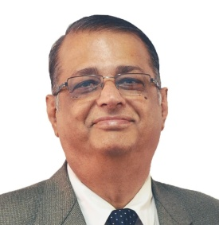
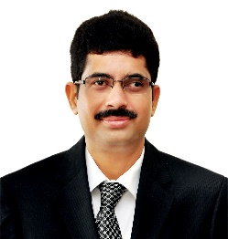
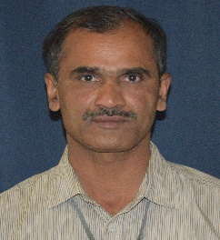
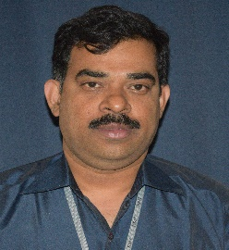
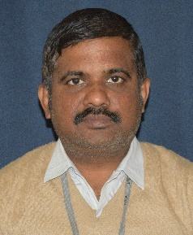
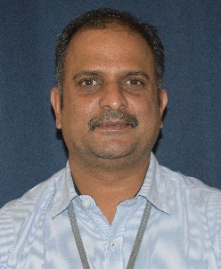
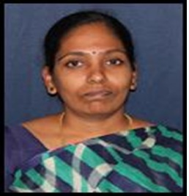

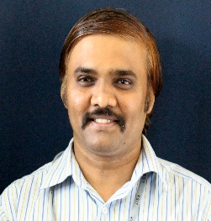

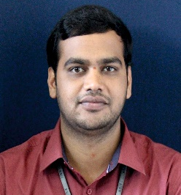
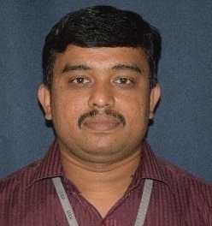
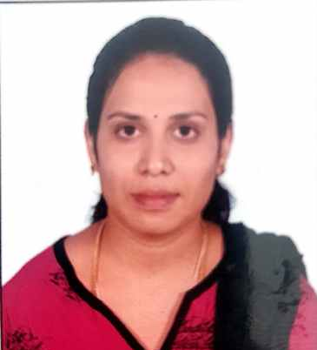
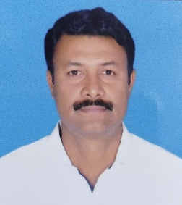
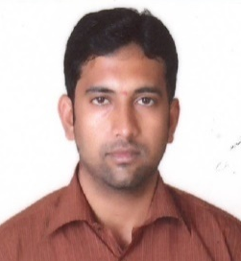
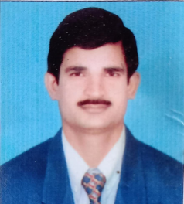
Teaching Staff
Professors
Associate Professors
Prof. NAGABHUSHANA
Prof. K PRASAD
Dr. NAGAPRASAD K S
Dr. GIRISH T R
Dr. NIRMALA L
Prof. ABHISHEK M R
Assistant Professors
Prof. MANJUNATH B R
Prof. RANGANATH N
Prof. HARSHA J
Prof. ANILKUMAR A
Prof. HARISH U
Prof. PARASHURAM A K
Prof. TEJASWINI M L
Dr. SALEEM KHAN
Prof. RAJESH G L
Prof. TRIMURTHY R

Slide 31
Student Faculty Ratio (SFR)
Student Faculty Ratio
Year | CAY 2020-21 | CAYm1 2019-20 | CAYm2 2018-19
Total No. of Students in the Department (S) | 394 | 505 | 534
No. of Faculty in the Department(F) | 14 | 22 | 23
Student Faculty Ratio (SFR) | 28.14 | 22.95 | 23.22
Average SFR | 24.77
Student Faculty Ratio (when Department applied for NBA accreditation)
Year | CAY 2019-20 | CAYm1 2018-19 | CAYm2 2017-18
Total No. of Students in the Department (S) | 505 | 534 | 532
No. of Faculty in the Department(F) | 21 | 23 | 21
Student Faculty Ratio (SFR) | 24.05 | 23.22 | 25.33
Average SFR | 24.2

Slide 32
Faculty Retention
Description | CAYm1[ 2018-19] | CAY [2019-20 ]
No. of Faculty Retained | 20 | 17
Total No. of Faculty (2017-18) | 21 | 21
% of faculty Retained | 95 | 81
Average | 88.00
Description | 2019-20 | 2020-21
No. of Faculty Retained | 20 | 12
Total No. of Faculty (2018-19) | 23 | 23
% of faculty Retained | 86.96 | 52.17
Average | 69.565

Slide 33
Research Paper Publications
Sl. No. | Academic year | Journals |  | Conferences |  | Total
 |  | International | National | International | National
1 | 2020-2021 | 5 | 2 | - | - | 7
2 | 2019-2020 | 10 | - | 2 | - | 12
3 | 2018-2019 | 15 | - | 3 | - | 18
4 | 2017-2018 | 10 | - | 1 | - | 11
 | Total | 40 | 2 | 6 | - | 48
33

Slide 34
Ph.D. Awarded under ME R & D Centre, KSIT, Affiliated to VTU
Sl. No. | Name of the Guide | Name of the Scholar | Title of Thesis | University | Year of completion
1 | Dr. K Chennakeshavulu | Hemadri Naidu.N | Process optimization of Tungsten Inert Gas (TIG) welding to improve Mechanical and corrosion resistant properties of Aluminium alloys. | VTU | 2018
2 | Dr. N.C. MahendraBabu | Anil Kumar.S | Fatigue life extension of noncircular cut-outs through cold expansion. | VTU | 2019
3 | Dr. T. V. Govindaraju | Madhura.S | Feasibility studies on utilization of Hall Magnetic Sensor for active magnetic bearing applications | VTU | 2019
4 | Dr. N. Krishnamurthy | Abhinav | Investigations on Plasma Sprayed Alumina and Calcia stabilized Zerconia functionally graded composite coatings. | VTU | 2020

Slide 35
Research Field of Scholars
Sl. No. | USN | Name | Guide | Title of the research work
1 | 1KS15PMJ01 | Mr. Abhishek M R | Dr. P.M. Suresh | A study of fiber reinforced composites by adding shear thickening fluid to evaluate mechanical property.
2 | 1KS15PMJ02 | Mr.Yogendra.P M | Dr.T.V.Govindaraju | Synthesis, Characterization and Testing of functional materials for additive manufacturing techniques.
3 | 1KS15PMJ03 | Mr.Chethan Kumar D S | Dr. Anilkumar. C | Studies on mechanical & Tribological Characteristics of Coated Nano oxide particle Reinforced Aluminium Composites.
4 | 1KS16PMJ04 | Mr.Mahaveer Bhaskar Khot | Dr. K.RamaNarasimha | CFD analysis of Gas Turbine combustor for performance improvement
5. | 1KS16PMJ02 | Mrs. Sreesudha | Dr.N. Krishnamurthy | Mechanical characterization of heat treated 7075 & 2024 Aluminium based metal matrix composites
6. | 1KS16PMJ03 | Mr. Manjunath B R | Dr. Srinivasa Reddy | Development and characterization of natural epipremnum-aureum/sisal fiber reinforced hybrid thermoplastic polymers.
7. | 1KS17PMA01 | Mr. Ranganath.N | Dr.Panchashari.H.V | Synthesis and characterization of poly lactic acid based composite with metal alloys wires.
8. | 1KS18PME01 | Karthik. R. | Dr. K.RamaNarasimha | Thermal characterization of pulsating heat pipes using Nano fluids
9. | 1KS18PME02 | Parashuram A K | Dr. K.RamaNarasimha | Experimental and theoretical studies on oscillating heat pipes using pure and binary mixture of fluids.
10 | 1KS19PME01 | Vikhan.G.B | Dr. K.RamaNarasimha | Studies on different types of fin heat exchangers

Slide 36
Criteria-6 Facilities and Technical Support
Sl. No. | Laboratory
1. | Computer Aided Engineering Drawing
2. | Work Shop
3. | Computer Aided Machine Drawing
4. | Energy Conversion Lab
5. | Computer Aided Modelling & Analysis Lab
6. | Design Lab
7. | Computer Integrated Manufacturing
8. | Material Testing Lab
9. | Foundry and Forging Lab
10. | Metrology and Measurement Lab
Sl. No. | Description | No.
1. | Class Rooms | 7
2. | Seminar Halls | 2
3. | HOD Office | 1
4. | Staff Cabins | 20
5. | R & D | 1
6. | Laboratories | 10
7. | Club workshop | 1
8. | Department Library | 1
9. | Project Lab | 1

Slide 37
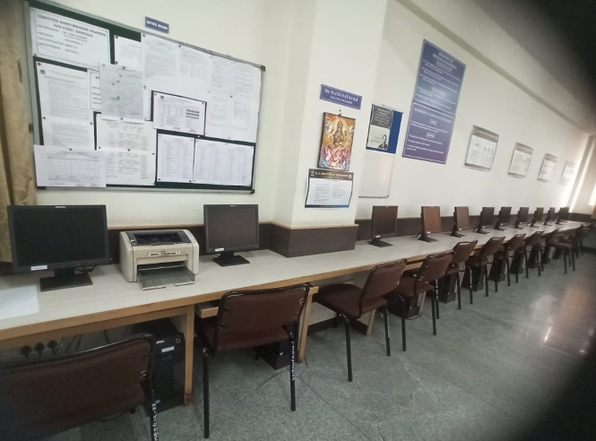
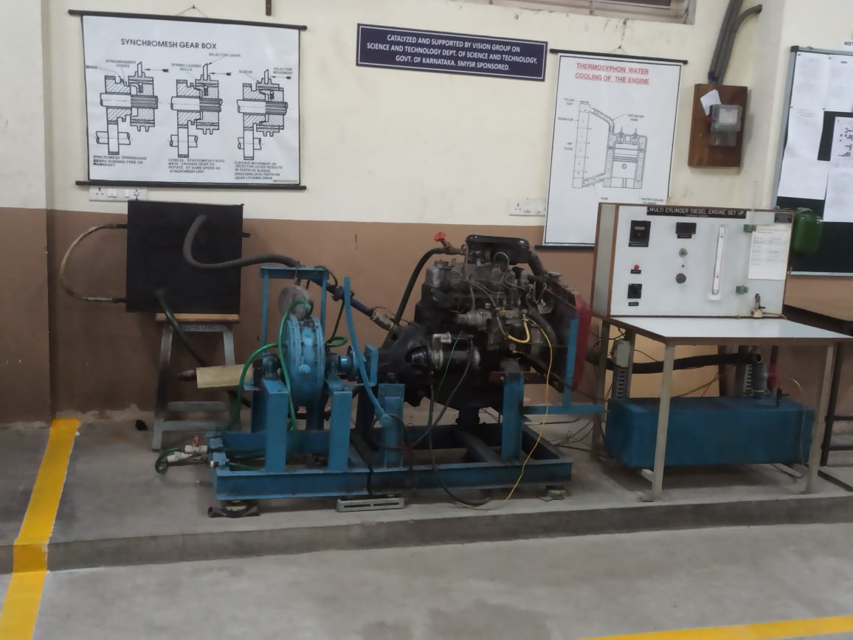
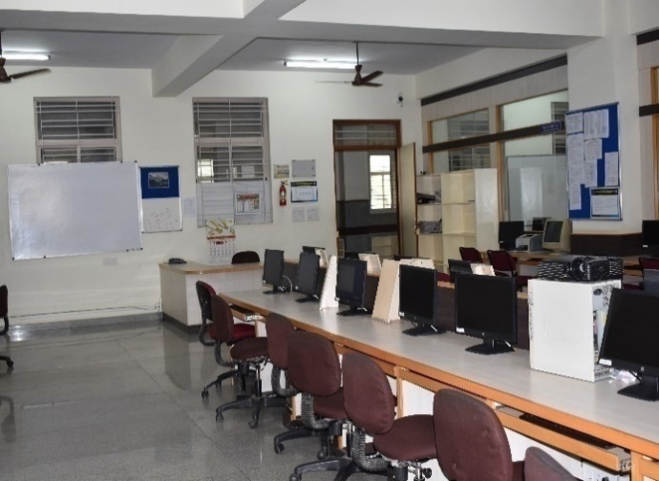
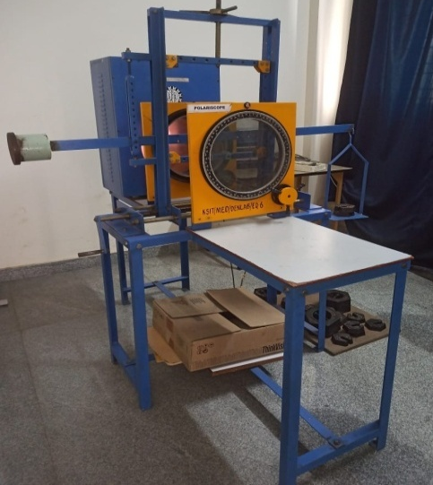
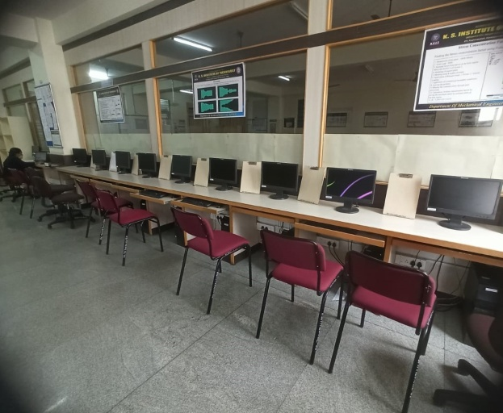
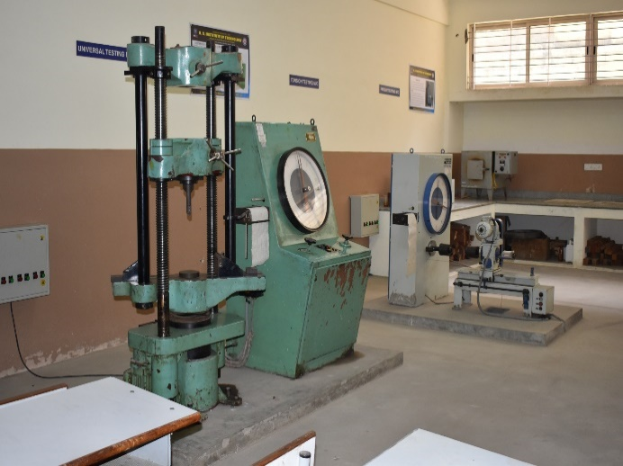
Facilities - Laboratories
Computer Aided Engineering
Drawing Lab
Energy Lab
Computer Aided Modelling
& Analysis Lab
Design Lab
Computer Integrated
Manufacturing Lab
Material Testing Lab

Slide 38

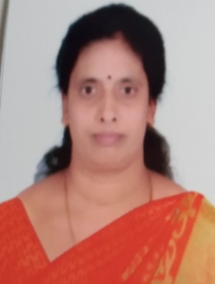
Technical and Supporting Staff
Sl. No | Name | Qualification | Designation
1 | Mr. PALAKSHA S | DME | Foreman
2 | Mr. G. THULASI BABU | (DME) | Instructor
3 | Mr. L. GOVINDA SWAMY | I.T.I | Instructor
4 | Mr. V. VENKATARAMANA | S.S.L.C & VTP | Instructor
5 | Mr. T.V. SEENA | S.S.L.C | Instructor
6 | Mr. A. MAHESH | B.A | Computer Operator
7 | Mr. K. VENKATESH | 8th Standard | Attender
8 | Mr. SANJAY K R | P. U. C | Attender
9 | Mrs. V. GEETHA | S.S.L.C | Attender
PALAKSHA S
THULASI BABU G
GOVINDA SWAMY L
VENKATARAMANA V
SEENA T V
MAHESH A
VENKATESH K
SANJAY K R
GEETHA V

Slide 39
Criteria-7 Continuous improvement
POs Attainment Levels and Actions for Improvement
POs | Target Level | Attainment Level |  | Observation
PO1 | Engineering knowledge
 | 1.8 | 2.27 | 1. Target is attained. 2. It is proposed to increase the target level in the next academic year.
Action 1 | Bridge course were conducted for the 1st Semester students before commencement of academic year
Action 2 | Conducted technical training program by the experts of particular domain for 7th Semester students to improve the knowledge in the engineering field.
POs | Target Level | Attainment Level |  | Observation
PO4 | Conduct investigations of complex problems
 | 1.6 | 1.56 | 1. Target is not attained.
Action 1 | Established the student chapter of Indian Institute of Foundry Men on 19th September 2019. The student chapter was inaugurated by Dr. R Ranganath, Chairman of IIF.

Slide 40
PSOs Attainment Levels and Actions for Improvement 2016- 20 Batch (2019-20)
PSOs | Target Level |  | Attainment Level |  | Observation
PSO1: Ability to apply concept of mechanical engineering to design a system, a component or a process/system to address a real world challenges.
PSO1 | 1.8 | 1.82 |  | Target is attained. It is proposed to increase the target level in the next academic year.
Action 1: Organised workshop on development of electric motor cycle from 31-10-2019 to 3-11-2019 by Mr. PiyushVerma, Alumini of KSIT, Bengaluru.
PSO2: Ability to develop effective communication, team work, entrepreneurial and computational skills.
PSO2 | 1.6 | 1.53 |  | Target is not attained
Action 1: Encouraged students to participate in various national conferences. Action 2: Students were given ideas on how to improve their leadership skills and how to manage a team. Action 3: Motivated students by organizing technical talks and project exhibitions. Action 4: Established a GO KART club in the department for the enhancement of skills in students.

Slide 41
Audit levels & responsibilities
Faculty Level Process
HOD
DAC
Module Coordinator
Preparation and Maintenance of Course File by Revising / refining of COs, COs-POs and COs-PSOs mapping.
CIA assessment, identification of weak and bright students on the basis of performance of student, assignment preparation & Preparation of Closing Report.
Course Coverage, Attendance monitoring, Physical verification of Classes and Labs, etc
PAC
Internal Audit
Verification of course files and personal file of all the faculties.
Analysis of PO attainment and preparation of action plan.
Overall Program Level Improvement.
Checking and coverage of COs in question papers
Monitoring quality of CIE papers and assignments
Submission of Audit Report.
External Audit
Verification of sample course file, student attendance record, sample blue books, Minutes of class committee meetings, student mentor process, faculty feedback, result analysis file, internal audit proofs.
Reporting on verification.

Slide 42
Progress of the program
Placement Details
Year | 2019-20 | 2018-19 | 2017-18 | 2016-17
Total number of students | 104 | 127 | 139 | 120
Total Number of Placed students | 54 | 34 | 34 | 46
Percentage of students placed | 51% | 26.77% | 24.46% | 38.33%

Slide 43
Outcome Based Education(OBE)
Framework for Outcome Based Education
Institute Vision and Mission
Program Outcomes
Washington Accord
Teaching Learning & Evaluation
Department Vision and Mission
Course Outcomes
Program
Program Educational Objectives
Graduate Engineer

Slide 44
Outcome Based Education(OBE)
Outcomes based education (OBE) is a process that involves the restructuring of curriculum, assessment and reporting practices in education to reflect the achievement of high order learning and mastery rather than the accumulation of course credits
  Benefits of OBE:
  More directed & coherent curriculum.
  Graduates will be more “relevant” to industry & other stakeholders (more well rounded graduates)
  Continuous Quality Improvement (CQI) is in place.

Slide 45
Outcome Based Education(OBE)
Students Under OBE
Students are expected to be able to do more challenging tasks other than memorize and reproduce what was taught.
Students should be able to: write project proposals, complete projects, analyze case studies, give case presentations, show their abilities to think, question, research, and make decisions based on the findings.
Be more Creative, able to analyze and Synthesize information.
Able to plan and organize tasks, able to work in team as a community to propose solutions to problems and market their solutions

Slide 46
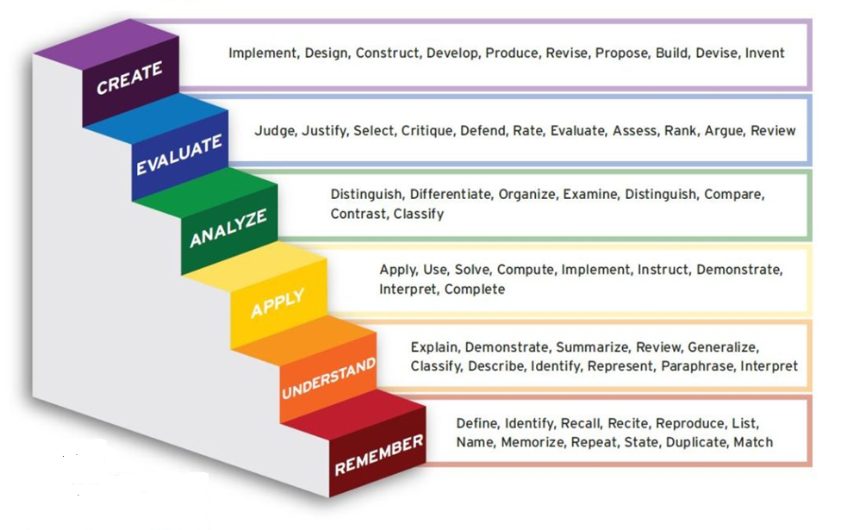
Bloom’s Taxonomy

Slide 47
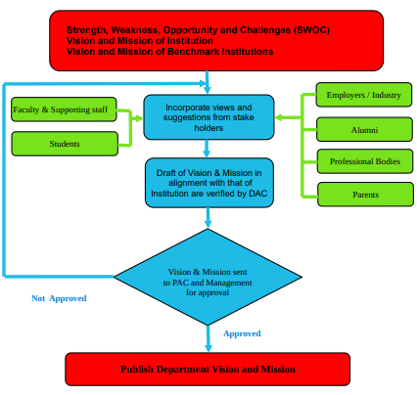
Process for defining Vision and Mission statements

Slide 48
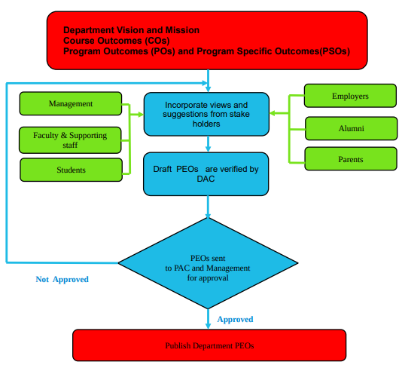
Process for defining
Program Educational Objectives (PEOs)

Slide 49
Process to Review & Refine Course Outcomes
University syllabus
CO Refining & Reviewing by Course Coordinators based on specific approach planned to handle the course
Bloom’s Taxonomy
PSO
Refined CO’s will be checked & scrutinized by the module coordinators
Updating of CO’s
If
recommended
Yes
No
Approved by HOD
Freezing & Adopting by Course Owner
Dept. of Mechanical Engineering
49

Slide 50
Process for CO-PO & CO-PSO Mapping
Course Outcomes
Mapping of CO-PO-PSO of the Course by course owners
Program
Outcomes
PSO
Mapping of CO-PO-PSO of the Course will be checked & scrutinized by the module coordinators
Updating of mapping
If
recommended
Yes
No
Approved by HOD
Adopted by course owner
Dept. of Mechanical Engineering
50

Slide 51
Curricular Gap Identification
University Curriculum
Before commencement of a batch
CO-PO/PSO mapping is done for the
courses & kept for Department Reference
Consolidated CO-PO Mapping table for courses (N) is prepared & documented.
T=Courses addressing PO/PSO
A= Summation of Mapping strength
For a given PO/PSO
T≥ 10 &
A≥ 30
University curriculum is substantial to address the said PO/PSO
Yes
No
% of curriculum gap (G) is calculated for PO/PSO
Department takes initiatives to bridge the gap by conducting events like workshops, seminars etc.
Dept. of Mechanical Engineering

Slide 52
Policies followed in Teaching Learning Process
K.S Institute of Technology is affiliated to VTU
For affiliated institution the Scheme & Syllabus will be framed by BOS in VTU & will be published in VTU website
Faculty are given freedom to review & refine the Course Outcomes based on the strength of the faculty profile
The refined course outcomes along with mapping of course outcomes with PO’s will be checked
Faculty will highlight the gaps obtained after mapping CO’s & PO’s for the course allotted along with pedagogy activities to minimize gaps
Consolidated CO PO mapping for all the courses will be used for finding the gap for a particular batch
Department level events will be planned to improve the conceptual & experimental learning for minimizing the gaps
Attainment is calculated for all courses considering SEE, CIE [Direct attainment] and Course end survey [Indirect]

Slide 53
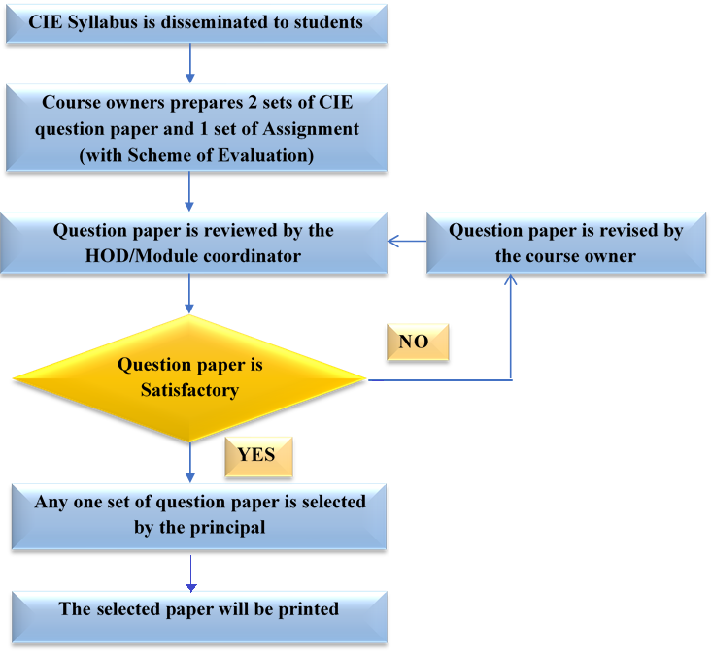
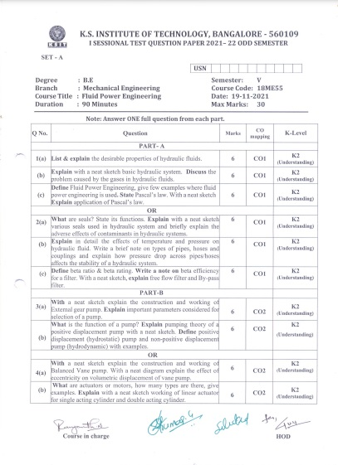
Quality of internal Assessment Question papers
Sample QP 2021-22 ODD semester

Slide 54
Process To Identify & Support Weak Students
Start of Academic Year
Analysis of Marks Scored after First CIE of Current Semester
Identify the Students scoring less than 50% of marks in first CIE for all the courses
Prepare a list of weak students and timetable for remedial classes and get it approved by the Head of the Department
Circulate the list of weak students among all the course owners
Conduct Remedial Classes
Mentors continuously monitor the academic progress of weak students
Monitor the performance of the students in subsequent 2nd and 3rd CIE
For few Students performance in the second and third CIE was improved

Slide 55
Process To Identify & Encourage Bright Students
Conduction of 1st CIE
Analysis of the marks scored after 1st CIE
Course Owners Prepares a list of students who have scored more than 50% of the marks in 1stCIE and identify them as Bright students
Encouraged to aim for Academic Excellence
Students are encouraged to participate in various competitions and are guided to publish technical papers
Top two students from each class are identified and suitably awarded with certificates, cash prize at Institute level

Slide 56
Identification of projects, allocation methodology and Evaluation
Area of specialization of the faculty along with the proposed project titles is shared
Students are informed to form the project groups & select the project title
Students are informed submit the synopsis to the coordinator
If the project idea is approved
Students are informed to refine the project topic & resubmit the synopsis
No
Guides are allotted by the HoD & Project coordinator
Project progress is monitored & evaluated in three phases
Consolidated marks is sent to University after the approval from the HoD & Principal
56

Slide 57
Assessment Tools used for CO Attainment Calculation
Direct Assessment
Indirect Assessment
CIE
Theory Assessment
Laboratory Assessment
Internship
project
Technical Seminar
SEE
External exams for
Theory &Lab
Internship
Project
Course End Survey
(B)
% of students scoring >=60% marks | Attainment Level
>= 50 and < 55% | 1
>= 55% and < 60% | 2
>= 60% | 3
50% CIE +
50 % SEE =
(A)
CO = 90 % Direct (A) +
10 % Indirect (B)

Slide 58
Faculty Performance Appraisal and Development System
Faculty fills and submits the appraisal form for the academic year
HOD reviews the self-appraisal forms, discusses & forward the same to the Head of the Institution
Head of the institution write the remarks and forwards to review committee
Committee members will evaluate and write review comments
Results obtained is 100%
Committee recommends required actions if any
Overall Performance Rating < 80%
Certificate of Appreciation
Advised to improve

Slide 59
Academic Audit Conduct Mechanism
Internal audit is done once in a semester by two senior faculty from other department
The department also undergoes external audit once in a year by academicians from other institutions
Audit observations from the internal audit The outcomes of External audit are placed before the Department Advisory Committee (DAC) for its implementation.
The outcomes from the DAC are placed before the Program Assessment Committee (PAC) for its approval
PAC discusses on the observations and if found necessary, then it gives approval for DAC for its implementation

Slide 60
Internal/External Academic Audit Process
Verification of
Sample Course File
Students Attendance Record
Sample Blue Book
Faculty Feed back
Result Analysis File
Mentoring process
Class committee details
Internal Audit Proof
Verification of
Course Files
Personal Files
External Audit
Internal Audit
Outcomes of Audit
Department Advisory Committee (DAC)
Audit observations for Approval
Approval for Implementation
Program Assessment Committee (PAC)

Slide 61
Conclusion
OBE is student centric and Improved learning process.
It will enhance the learning opportunities for teachers that reinforce and expand their knowledge
Increased institutional effectiveness
Enhanced accountability in Teaching and Learning process
Quality education
Development is measurable & linked
  Program outcomes /course outcomes
  Program Educational Objectives
  Assessment & Evaluation
Teachers' Learning will be a valuable resource for classrooms, Departments, and professional organizations.

Slide 62


