Slide 1


Kammavari Sangham (R) 1952, K.S.Group of Institutions
K. S. INSTITUTE OF TECHNOLOGY
(Affiliated to VTU, Belagavi & Approved by AICTE, New Delhi, Accredited by NAAC )
#14, RAGHUVANAHALLI, KANAKAPURA ROAD, BENGALURU – 560 109
HEARTY WELCOME
TO
NBA EXPERT COMMITTEE MEMBERS
DEPARTMENT OF COMPUTER SCIENCE AND ENGINEERING
Presented by
Dr. Rekha B Venkatapur
HOD CSE

Slide 2
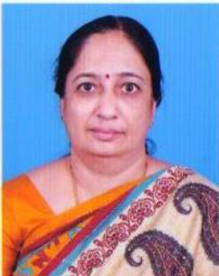
Dr. Rekha B Venkatapur _{PhD, CSE}
Professor & Head
DEPT. OF CSE
Education: B.E CSE – BEC, KUD – 1988 MTech CSE – BMSCE, VTU - 2004 PhD CSE – JNTUH - 2016 | Experience: Teaching Experience – 29 Years
Ph.D Guiding: Supervisor ID - VTU0817524 VTU, Belagavi – 5 | Journal Publication International Journals - 8 International Conference - 3 National Conferences - 2
Memberships in Professional Bodies Life member ISTE no: LM15102 Fellow IEI No: F-121672-0 CSI Membership: F8000118 | Roles /Responsibilities at VTU BoS –CSE/ISE Board, Member (2019 – 2022) BoE – Member (2018-2019) BoE – Member (2015-2016)

Slide 3

Inception and Programs offered by the
CSE Department
Year of establishment of CSE Department: 1999
Sanctioned Intake for UG in the year 1999: 60
Increase in intake in the year 2008 : 120
Present Sanctioned intake : 120
Programs offered in CSE department
Under graduation [UG] - Number of Batches Graduated - 19
Post Graduation [PG] - Computer Science and Engineering
PhD

Slide 4

Department Information
Faculty, Infrastructure and Students
98.33%
Enrolment Ratio (In last three years)
24
Female Faculty –10
Male Faculty - 14
7
Laboratories
Professors
6
Class Rooms
77%
Avg. Pass % in last three years
3
Associate Professors
447
Department Library Books
4
70%
Placements
Assistant Professors
1
Centre of Excellence- IoT
17
2
VTU Ranks
Faculty with Ph.D.
R&D Lab
7
1
15
Number of Students joined for Higher Studies
Faculty Pursuing Ph.D
1
Project Lab
4
2
Entrepreneur
Faculty Publications
1
HOD Office
38
Faculty Cabins
286
Online Certification courses
Faculty Patents Filled
16
8
500 Mbps
Internet Bandwidth
5
Professional Bodies- CSI,IEEE,IEI,BITES,ISTE
3
Consultancy Services
1
Seminar Hall
KSCST Student Projects selected
(in last 3 Years)
5

Slide 5
Department Achievements
Sl. No | Year | Events Organised in the Department | Collaborating Organization/ Professional Bodies | Participants
1 | 2021 | Hackathon | Incubate India and Github | 204 Participants from KSIT
2 | 2020 | 34th Karnataka State level CSI Student convention | CSI | 261 Participants From Colleges of Karnataka
3 | 2019 | State level 24 Hrs Hackathon Sentinel Hack 2.0 | - | 256 Participants from Karnataka in 72 Teams
4 | 2018 | Sentinel Hack 24 Hrs State level Hackathon | - | 189 Participants from Karnataka in 54 teams
5 | 2018 | 30th Karnataka State level CSI Student convention | CSI | 400 Participants
6 | 2017 | NaCoNIM – National Level Conference | - | 41 Papers presented

Slide 6
Faculty Achievements – Awards, Recognition
Sl.No | Year (Duration) | Faculty | Achievement / Award / Recognition | Organization/ University
1 | 2019-22 | Dr Rekha B Venkatapur | Member, BoS CSE/ISE Board | VTU
2 | 2021 | Dr Ram P Rustagi | 3rd prize in iSIGCSE Teaching COMPUTE’21 Challenge | ACM India
3 | 2020
 |  |  | Most outstanding Professor award | World Education Congress
4 | 2020 | Mr Pradeep Kumar G H | Judge for “Smart India Hackathon 2020 ” software edition | MHRD
5 | 2019 | Mr. Aditya Pai H | Best Paper Award in International conference | Elsevier SSRN publications and SJCIT
6 | 2017-18 | Dr. Dayananda R B | Governor's National Award for Excellence in Research & Development | Government of Karnataka
7 | 2020-21 | Dr Ram P Rustagi | Consultancy Services Rs 50,000/- per Month; Ongoing | 1 Personal Air Quality Systems(PAQS) Pvt.Ltd
8 | 2019-20 |  | Rs. 4,50,000/- Completed | UpGrad Education
9 | 2019-20 |  | Rs. 7,01,807/- Completed | PayTM

Slide 7
Faculty Achievements – Awards, Recognition
SL.No | Year | Faculty | Achievement / Award / Recognition | Organization/ Professional Body
10 | 2018 | Dr Deepa S R | Longest Continuous SBC award | CSI
11 | 2019 |  | Young Achiever Award | IEAE
Patents – Filled
SL.No | Year | Number of Faculty | Details | National/International | Number of Patents
1 | 2019-20 2020-21 | 6 | Patents | National | 7
2 | 2020-21 | 3 | Patent | International | 1
Online Courses
SL.No | Year | Number of Faculty | Number of Courses
1 | 2020-21 | 7 | 23
2 | 2019-20 | 12 | 24
3 | 2018-19 | 2 | 3

Slide 8
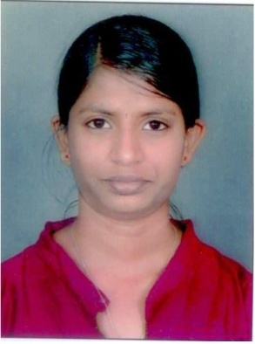
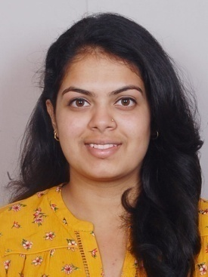

Student Achievements
Academic Achievement
VTU Ranks
2017-2018
10th Rank (83.10%)
Ms. Maanasa Narayan
USN - 1KS14CS051
(Batch 2014-2018)
7th Rank (83.94%)
Ms. Chaitra R.
USN - 1KS14CS029
(Batch 2014-2018)

Slide 9



Student Achievements
National Level - SIH & TOYCATHON
STUDENT LEVEL ACHIEVEMENTS/RECOGNITION
KSIT CSE Teams in Smart India Hackathon(SIH)
2017
“BIT- Hackers” Winner of SIH 2017 for Ministry of POST
“ELECTRIC SHEEP” Winner of SIH- 2018 for Ministry Of Railways.
2018
“ECHO 18” 1st Runner up of SIH- 2018 for Ministry of Telecom.
2019
“CRYPTIC_CODERS” Winner of SIH 2019 - for Ministry of Power
“PACMAN BYTES” Winner of SIH 2019 for Ministry of Civil Aviation
2021
[online] Contagious intelligence –1. Winner @UP Nodal Center
[online] Contagious intelligence –2 . Winner @TN Nodal Center
Winner
1,00,000/-
1st Runner up
75,000/-

Slide 10

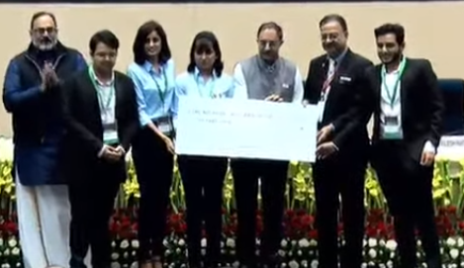
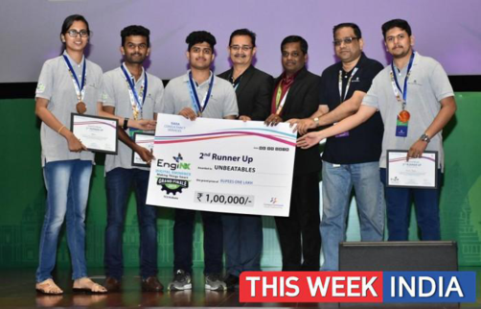
Student Achievements
National Level
2nd Runner up
Team : Ctrl-Alt-Elite
Prize Money
1,00,000/-
TATA Consultancy Services (TCS)
EngiNX- 2019
1st Runner up
Team : Unbeatables
Prize Money
1,00,000/-

Slide 11
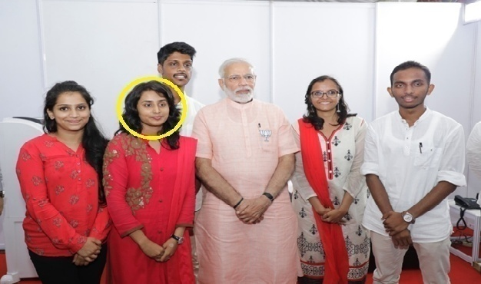
Students Achievement -State Level
Dhananjay(1KS18CS18) and Gowtham(1KS18CS24) of pre final year participated in 2-day national-level online hackathon conducted by the CSI Student Branch of Mysuru in ATME College of Engineering and won 2nd Prize in July 2021.
Pranav M S (1KS18CS69) and Raksha S (1KS18CS80)- Won first prize in the 24 Hour Hackathon conducted by NMIT on 19th and 20th June 2021.
Ketan Keshav(1KS16CS033) got BEST IEEE STUDENT BRANCH EXECOM VOLUNTEER AWARD 2020
Abhishek M (1KS16Cs001) , Ketan K(1KS16CS033) , Nagalekha R- (1KS16CS49) Won 2nd Prize in Hackfest during September 2018 organized by SIT Tumkur, Karnataka.
Sai Shashika(1KS15CS84) and others participated in an event organized by the Karnataka Govt - “New Bengaluru for New India “ in the year 2018.
KSIT Team won and received cash price of Rs 25,000.00 from Hon’ble Prime Minister Shri Narendra Modi for providing an idea to solve water problem “ಕುಡಿವ ನೀರಿಗೂ ಗತಿ ಇಲ್ಲ ಜನರ ಬವಣೆಗೆ ಮಿತಿ ಇಲ್ಲ”.

Slide 12
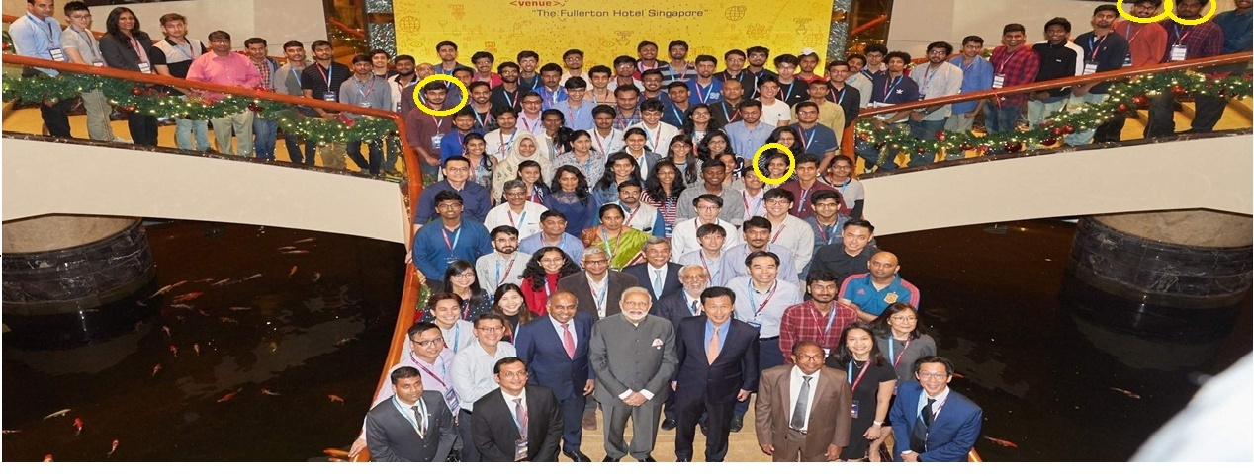
Students Achievement
International Level participants
Abhishek M (1KS16CS001), Apoorva R (1KS14CS018), Aditya Kumar (1KS15CS006), Shrisha Mahuli (Alumni mentor- 2009-13 Batch) of Computer Science & Engineering were selected for India-Singapore Hackathon-2018 held at Nanyang Technological University (NTU), Singapore.

Slide 13
Criteria-1 Institute & Department Vision, Mission
 | Institute | Department
VISION | To impart quality technical education with ethical values, employable skills and research to achieve excellence. | To create competent professionals in Computer Science and Engineering with adequate skills to drive the IT industry.
MISSION | M1: To attract and retain highly qualified, experienced and committed faculty. M2: To create relevant infrastructure M3: Network with industry and premier institutions to encourage emergence of new ideas by providing research and development facilities to strive for academic excellence M4:To inculcate the professional and ethical values among young students with employable skills and knowledge acquired to transform the society | M1: Impart sound technical knowledge and quest for continuous learning. M2: To equip students to furnish Computer Applications for the society through experiential learning and research with professional ethics. M3: Encourage team work through inter-disciplinary project and evolve as leaders with social concerns.

Slide 14
Department PEO’s and PSO’s
PROGRAM EDUCATIONAL OBJECTIVES (PEOs):
PEO1: Excel in professional career by acquiring knowledge in cutting edge Technology and contribute to the society as an excellent employee or as an entrepreneur in the field of Computer Science & Engineering.
PEO2: Continuously enhance their knowledge on par with the development in IT industry and pursue higher studies in computer science &engineering.
PEO3: Exhibit professionalism, cultural awareness, team work, ethics, and effective communication skills with their knowledge in solving social and environmental problems by applying computer technology.
PROGRAM SPECIFIC OUTCOMES (PSOs):
PSO1: Ability to understand, analyze problems and implement solutions in programming languages, as well to apply concepts in core areas of Computer Science in association with professional bodies and clubs.
PSO2: Ability to use computational skills and apply software knowledge to develop effective solutions and data to address real world challenges.

Slide 15
Criteria-2 Program Curriculum &
Teaching Learning Process
 | Batch | CIE | SEE
Choice Based Credit System (CBCS) 2015 scheme | 2015-19 | 20 | 80
 | 2016-20 | 20 | 80
2017 Scheme | 2017-21 | 40 | 60
2018 Scheme | 2018-22 | 40 | 60
Continuous Internal Evaluation per semester 3 (CIE):
Test Question papers are prepared following New Bloom’s Taxonomy
Lab Assessment
Project
Internship
Technical Seminar
Semester End Examination once per semester (SEE):
Conducted & evaluated by faculty deputed by university
Assessment of Internship and Project work is done as per university norms

Slide 16
Teaching Learning Process
Preparation of Dept. calendar of events inline with college & VTU calendar of events
Subject allotment & Preparation of lesson plan & Timetable
Course outcomes of the new courses added to the curriculum are mapped with PO’s, Gaps in Curriculum are identified and steps are taken to bridge the same
Monitoring the performance of students through continuous evaluation
Identifying bright & slow learners and motivating them for better learning
Two Feedbacks are taken from students on teaching learning process every semester
Semester End Examination

Slide 17
Delivery Details for Teaching learning Process
SL. No. | Method | Content Delivery | Facility
1 | Class Room teaching/student centric pedagogy activities | Power Point Presentation | ICT Tools
 |  | Quiz
 |  | Group discussion
 |  | Learning by Gaming
 |  | Problem solving
 |  | Case Study
2 | e-Learning | Collaborative Platform | Internet, Digital Library, YouTube, Microsoft teams
 |  | NPTEL videos
 |  | Webinars
3 | Evaluation Assessment / Improvement | Internal assessments | Study material - notes, question banks & previous years university Question papers
 |  | Assignments
4 | Communication | e-mail Communication, Messages through Website, Other social Media Groups like WhatsApp based Interaction | ICT Tools

Slide 18
Student’s Projects Details
Academic Year | 2020-21 | 2019-20 | 2018-19
Total Number of Project Batches | 27 | 33 | 31
Number of research papers published by students | 18 | 35 | 10
Number of funded projects | 2 | - | 3
Best Projects of the year | 1. Be my book. 2. Voice based E-Prescription. | 1. Smart Gesture Controller. 2. Data Extraction from a Digital Text file and conversion into an Audio -Visual output | 1. A Self Sustaining, Secured Live Patient Video Streaming System for Hospitals. 2. Smart campus communication system.

Slide 19
Criteria-3 Program Outcomes & Course Outcomes
C306.1 | Identify the UNIX features, architecture, structure and organization of UNIX file system.
C306.2 | Construct the regular expression for grep commands and implement shell programs.
C306.3 | Develop system programs using different categories of API’s.
C306.4 | Build Inter-process communication using various techniques.
C306.5 | Utilize POSIX API for implementing signals.
CO | PO1 | PO2 | PO3 | PO4 | PO5 | PO6 | PO7 | PO8 | PO9 | PO10 | PO11 | PO12 | PSO1 | PSO2
C306.1 | 3 | 1 | 1 | - | 2 | - | - | - | 2 | - | - | - | 2 | -
C306.2 | 3 | 2 | 2 | - | 2 | - | - | - | 2 | - | - | - | 2 | 2
C306.3 | 3 | 2 | 2 | - | 2 | - | - | - | 2 | - | - | - | 2 | 2
C306.4 | 3 | 2 | 2 | - | 2 | - | - | - | - | - | - | - | 2 | 2
C306.5 | 3 | 1 | 1 | - | - | - |  | - | - | - | - | - | 2 | 2
C306 | 3 | 1.6 | 1.6 | - | 2 | - | - | - | 2 | - | -- | - | 2 | 2

Slide 20
Curriculum Gap for 2016-20 Batch
 | PO1 | PO2 | PO3 | PO4 | PO5 | PO6 | PO7 | PO8 | PO9 | PO10 | PO11 | PO12 | PSO1 | PSO2
No. of subjects mapped | 52 | 51 | 48 | 18 | 21 | 13 | 6 | 5 | 13 | 9 | 6 | 18 | 36 | 38
Value of ‘A’ | 142.30 | 120.19 | 95.76 | 31.18 | 41.30 | 19.85 | 8.80 | 8.90 | 24.20 | 20.40 | 9.93 | 26.00 | 87.40 | 61.60
Percentage of curriculum gap ‘G’ |  |  |  |  |  | 17 | 63 | 62.90 |  | 15 | 58.60

Slide 21
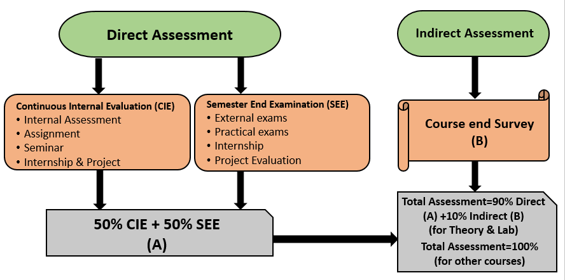
Assessment Tools for Course Outcomes

Slide 22
Target of 60% is set for CIE and SEE for each course.
The total no. of students appearing for the subject is identified as [N]
No. of students scoring greater than the set target [60%] is calculated [N1].
The percentage of students scoring greater than the set target is computed as N1/N * 100
SEE & CIE
Process for Attainment through
CIE & SEE
Level 3 – 60% students should have scored >= 60% of Maximum marks
Level 2 – 55% students should have scored >= 60% of Maximum marks
Level 1 – 50% students should have scored >= 60% of Maximum marks
Based on the percentage obtained, the Attainment level for each of the CO is identified

Slide 23
Assessment Tools for Course Outcomes
Direct Assessment Tools
Sl. No. | Components | Sub-Components | Weightage (%) | Total Weightage (%)
A1 | Theory | Three Internal Tests | 50 | 90
 |  | One University Examination | 50
A2 | Laboratory | Continuous Evaluation through observation book, record book and Viva Voce, Internal Tests | 50 | 90
 |  | University Examination | 50
A3 | Internship | Internal evaluation of Internship | 50 | 100
 |  | External evaluation of Internship | 50
A4 | Project Work | Internal evaluation of project work | 50 | 100
 |  | External evaluation of project work | 50
A5 | Seminar | Internal Evaluation | 100 | 100
Sl. No. | Components | Sub Component | Weightage (%)
A1 | Theory | Course End Survey | 10
A2 | Laboratory | Course End Survey | 10
Indirect Assessment Tools

Slide 24
Process for CO Attainment Calculation
Sl. No. | CO Attainment Calculation
1 | To Obtain the Attainment level 50% of internal test attainment is considered as [N1] and 50% of university Attainment and is considered as [N2] for every CO.
2 | The Attainment is calculated as [N1 + N2] for every CO and 90% of this will be calculated as [N3].
3 | 10% of Course end survey Attainment level is obtained as [N4].
4 | The Final Attainment of the course is given by [N3 + N4] for every CO.
CO | CIE | [N1] | SEE | [N2] | DIRECT ATTAINMENT 50% of [N1]+ 50% of [N2] | LEVEL | [N3] 90% of ([N1]+[N2]) | INDIRECT ATTAINMENT Course end survey | LEVEL | [N4] 10% of Course end survey | ATTAINMENT LEVEL [N3]+[N4]
CO1 | 96.31 | 48.16 | 63.50 | 31.80 | 79.91 | 3.00 | 2.7 | 91.00 | 3.00 | 0.3 | 3.00
CO2 | 95.05 | 47.53 | 63.50 | 31.80 | 79.28 | 3.00 | 2.7 | 91.00 | 3.00 | 0.3 | 3.00
CO3 | 97.34 | 48.67 | 63.50 | 31.80 | 80.42 | 3.00 | 2.7 | 91.00 | 3.00 | 0.3 | 3.00
CO4 | 91.47 | 45.74 | 63.50 | 31.80 | 77.49 | 3.00 | 2.7 | 91.00 | 3.00 | 0.3 | 3.00
CO5 | 83.08 | 41.54 | 63.50 | 31.80 | 73.29 | 3.00 | 2.7 | 91.00 | 3.00 | 0.3 | 3.00
AVG |  |  |  |  |  |  |  |  |  |  | 3.00

Slide 25
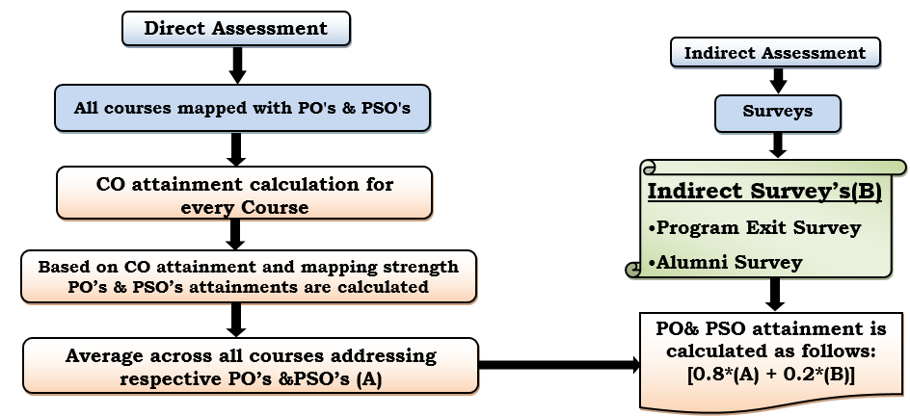
Assessment Tools used for PO & PSO Attainment Calculation

Slide 26
Attainment of POs and PSOs
 | PO1 | PO2 | PO3 | PO4 | PO5 | PO6 | PO7 | PO8 | PO9 | PO10 | PO11 | PO12 | PSO1 | PSO2
Direct Attainment [A] | 2.30 | 1.95 | 1.64 | 1.61 | 1.76 | 1.41 | 1.30 | 1.47 | 1.84 | 2.28 | 1.73 | 1.36 | 1.83 | 1.24
Indirect Attainment [B] | 3.00 | 3.00 | 3.00 | 3.00 | 3.00 | 3.00 | 3.00 | 3.00 | 3.00 | 3.00 | 3.00 | 3.00 | 3.00 | 3.00
C= A * 0.8 | 1.84 | 1.56 | 1.31 | 1.29 | 1.41 | 1.13 | 1.04 | 1.17 | 1.47 | 1.82 | 1.38 | 1.09 | 1.47 | 1.00
D = B * 0.2 | 0.60 | 0.60 | 0.60 | 0.60 | 0.60 | 0.60 | 0.60 | 0.60 | 0.60 | 0.60 | 0.60 | 0.60 | 0.60 | 0.60
Total Attainment [C+D] | 2.44 | 2.16 | 1.91 | 1.90 | 2.01 | 1.73 | 1.64 | 1.77 | 2.07 | 2.42 | 1.98 | 1.69 | 2.07 | 1.60
 | PO1 | PO2 | PO3 | PO4 | PO5 | PO6 | PO7 | PO8 | PO9 | PO10 | PO11 | PO12 | PSO1 | PSO2
2015-19 | 2.44 | 2.17 | 1.98 | 1.91 | 2.17 | 1.69 | 1.79 | 1.83 | 2.03 | 2.33 | 1.84 | 1.64 | 2.22 | 1.70
2016-20 | 2.44 | 2.16 | 1.91 | 1.90 | 2.01 | 1.73 | 1.64 | 1.77 | 2.07 | 2.42 | 1.98 | 1.69 | 2.07 | 1.60
2017-21 | 2.61 | 2.24 | 2.05 | 1.78 | 2.10 | 1.84 | 1.90 | 1.84 | 1.90 | 1.89 | 1.79 | 1.75 | 2.35 | 1.79

Slide 27
Criteria-4 Student’s Performance
Students admitted to the program
Item | CAY 2020-21 | CAYm1 2019-20 | CAYm2 2018-19
Sanctioned Intake of the program (N) | 120 | 120 | 120
Total number of students admitted in first year minus number of students migrated to other programs / institutions plus no. of students migrated to this program (N1) | 114 | 114 | 124
Number of students admitted in 2nd year in the same batch via lateral entry (N2) | - | 05 | 15
Separate Division Students. If applicable (N3) | - | 2 | 2
Total number of students admitted in the Program (N1 + N2 + N3) | 114 | 121 | 141
% Enrolment Ratio= N1/N | 95 | 100 | 100
Average Enrolment Ratio | 98.3

Slide 28
Successfully Graduated Students with and without backlogs
YEAR OF ADMISSION | 2016-17 | 2015-16 | 2014-15 | Success Index
Year of Completion | 2019-20 | 2018-19 | 2017-18 | 0.47
No. of Students Admitted | 127 | 140 | 149
No. of Students Appeared for Exam | 110 | 117 | 115
No. of Students Successfully Completed Without Backlogs | 65 | 69 | 62
Success Index without Backlog | 0.51 | 0.49 | 0.42 | 0.77
No. of Students Successfully Completed With Backlogs | 103 | 112 | 103
Success Index with Backlog | 0.81 | 0.80 | 0.69
Percentage of students successfully completed in 4 Years | 81.10 | 80 | 69.13

Slide 29
Placements, Higher Studies and Entrepreneurs
Item | LYG 2016-17 | LYGm1 2015-16 | LYGm2 2014-15
Total No. of Final Year Students (N) | 110 | 117 | 115
No. of students placed in companies or Government Sector (x) | 87 | 76 | 57
No. of students admitted to higher studies with valid qualifying scores | 3 | 5 | 7
No. of students turned entrepreneur in engineering/ technology (z) | 1 | 1 | 0
x + y + z = | 91 | 82 | 64
Placement Index : (x + y + z )/N | 0.83 | 0.7 | 0.56
Average placement= (P1+ P2 +P3)/3 | 0.7

Slide 30
Publications by Students
Year | Journals | Conferences
2020-21 | 9 | 12
2019-20 | 47 | 1
2018-19 | 29 | 5
Total number of Journals published by student from 2018 to 2021 are 85 & Presented in conferences are : 18

Slide 31

Department News Letter
Volume 1 2016
Volume 2 MAY-2017
Volume 3 MARCH -2018
Volume 4 DEC- 2018
Volume 5 JUNE- 2019
Volume 5 DEC- 2019
Volume 6 JUNE- 2020
Volume 6 DEC- 2020

Slide 32
Criteria-5 Faculty Information and Contribution
Faculty Details
Total faculty: 24
UG/PG handling faculty: 22
First Year : 2
Associate Professors : 4
Assistant Professors :15
Assistant Professors: 2
Professors : 3

Slide 33
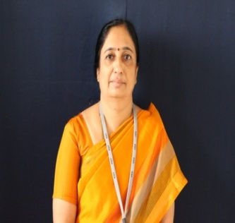
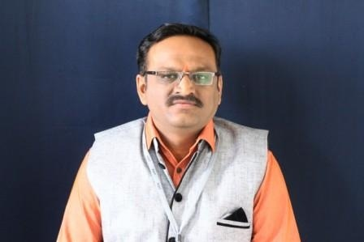
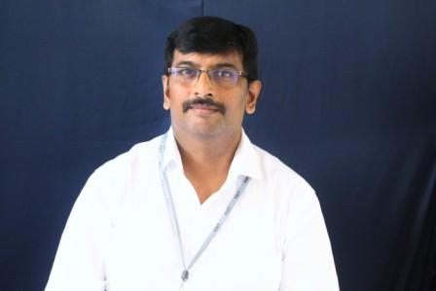
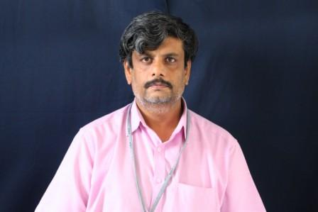
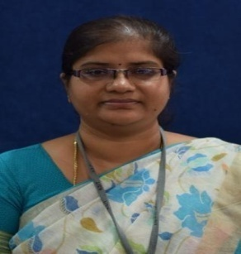
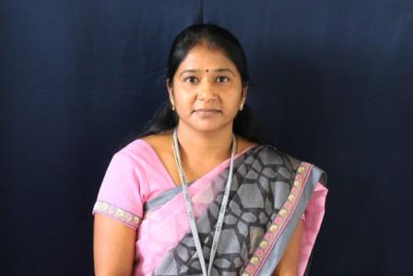
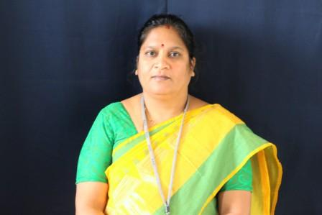
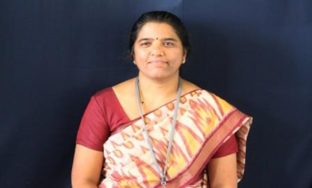
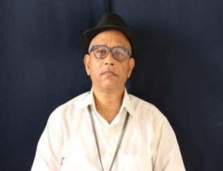
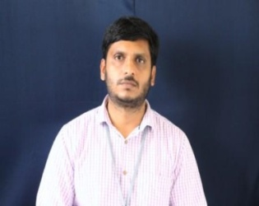
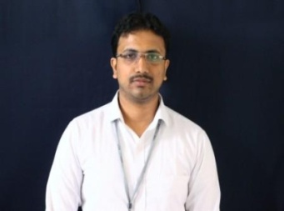
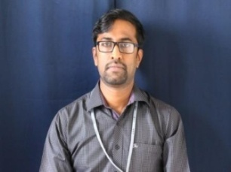
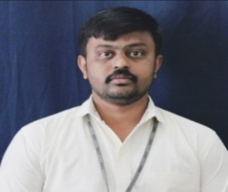

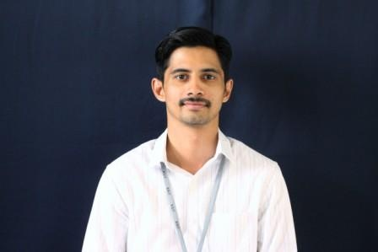
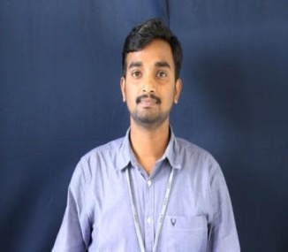
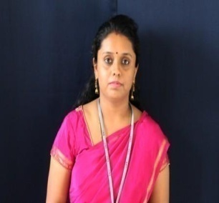
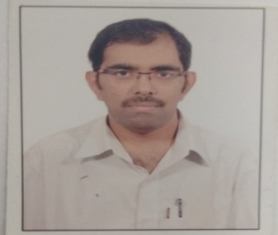
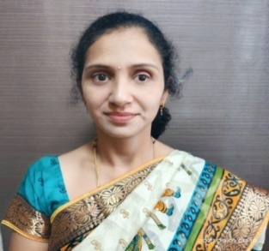
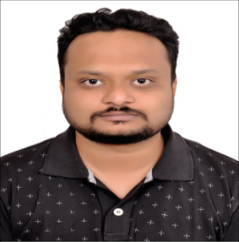
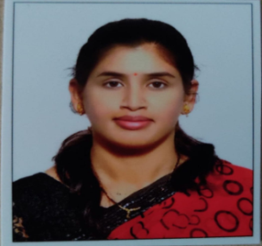
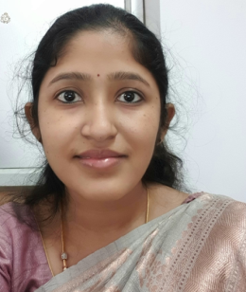
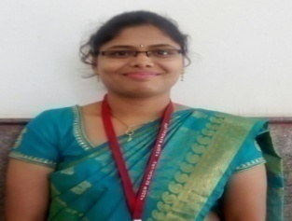
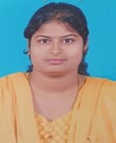
Dr. REKHA B VENKATAPUR,
Professor & Head
Dr.DAYANANDA R B,
Professor
Dr. VENKATA RAO,
Professor
Mr.HARSHAVARDHAN J R
Assoc. Professor
Mrs. DEEPA S R
Assoc. Professor
Dr.VANEETA M
Assoc. Professor
Dr. VIJAYALAXMI MEKALI
Assoc .Professor
Mrs. SOUGANDHIKA N
Asst Professor
Mr.SANJOY DAS
Asst Professor
Mr. ROOPESH KUMAR B N,
Asst Professor
Mr. KUSHAL KUMAR B N
Asst. Professor
Mr. KUMAR K
Asst. Professor
Mr. RAGHAVENDRACHAR S
Asst. Professor
Dr SWATHI K
Asst. Professor
Mr. KRISHNA GUDI
Asst. Professor
Mr. Prashanth H S
Asst. Professor
Mrs. BEEENA K
Asst. Professor
Mr. ANIL KUMAR C
Asst. Professor
Mrs. SWAPNA G
Asst. Professor
Mr. MANOJ KUMAR S
Asst. Professor
Mrs. GEETHA R,
Asst. Professor
Mrs. PALLAVI K N
Asst. Professor
Mrs. GEETHANJALI R
Asst. Professor
Mrs. DAKSHAYINI
Asst. Professor

Slide 34
Student Faculty Ratio (SFR)
Description | CAY(2020-2021) | CAYm1(2019-20) | CAYm2 (2018-19)
Total No. of Students in the Department (UG+PG) (S) | 418 | 427 | 434
No. of Faculty in the Department(F) | 21 (F1) | 22 (F2) | 23 (F3)
Student Faculty Ratio(SFR) | SFR1=S1/F1 = 19.90 | SFR2=S2/F2 = 19.41 | SFR3=S3/F3 = 18.87
Average SFR | SFR=(SFR1+SFR2+SFR3)/3 = 19.39
F=Total Number of Faculty Members in the Department (excluding first year faculty)

Slide 35
Faculty Retention
Description | CAYm1 [2019-20] | CAY [2020-21]
No. of Faculty Retained | 19 | 18
Total No. of Faculty | 23 | 23
% of faculty Retained | 82.60 | 78.26
Average | 80.43

Slide 36
Research Publications by Faculty
 | 2020-21 |  |  | 2019-20 |  |  | 2018-19 |  |  | 2017-18
 | Books | Book Chapters | Journals | Books | Book Chapters | Journals | Books | Book Chapters | Journals | Books | Book Chapters | Journals | Total
WEB OF SCIENCE |  |  | 2 |  |  | 1 |  |  | 1 |  |  |  | 4
SCOPUS |  | 1 | 8 |  | 1 | 4 | 2 |  | 2 | 2 | 1 |  | 21
IEEE/SPRINGER CONFERENCE |  |  | 3 |  |  | 4 |  |  | 1 |  |  | 3 | 11
Total | 14 |  |  | 10 |  |  | 6 |  |  | 6 |  |  | 36

Slide 37
Other Publications by Faculty
Sl. No | Academic year | Books | Book chapters | Journals | Conferences |  | Total
 |  | International | International | International | International | National
1 | 2020-2021 | - | 1 | 18 | 10 | 10 | 39
2 | 2019-2020 | - | 1 | 56 | 7 | - | 64
3 | 2018-2019 | 2 | - | 53 | 4 | 4 | 63
Total | Total | 2 | 2 | 127 | 21 | 14 | 166

Slide 38
Research Supervisors and Research Scholar Details in CSE R & D Centre
Research Supervisor Details | Number of Research Scholar registered under CS R&D and Status | Total number of research scholars in CS R& D | Status Of Research Scholars work In CSE R&D
Dr. Rekha B Venkatapur | 5 | 14 | PhD awarded for 4 Scholars from till Year 2021 PhD Defense is completed by one scholar, applied for PDC 3 Students have completed Comprehensive Viva 3 have Completed Course Work 3 are awaiting for course work results
Dr. Dayananda R B | 4

Slide 39
Facilities and Technical Support
Criteria-6
Sl. No. | Laboratory | Space (Sq. mts.)
1. | Machine Learning Laboratory and DBMS Laboratory/Project Work | 108
2. | Computer Network Laboratory/Project Work | 108
3. | Data Structures Laboratory / Design And Analysis Of Algorithm Laboratory and System Software and Operating System Laboratory | 83
4. | Web Technology Laboratory / DBMS Laboratory/ Computer graphics Laboratory | 113
5. | Analog And Digital Electronics Laboratory / Microcontroller and embedded system Laboratory/ System Software and Operating System Laboratory | 136
6. | Computer Programming Laboratory | 118.5
7. | Mobile Application Development Laboratory | 82
8. | Research & Development | 82
9. | Project work Laboratory | 94.2
Sl. No. | Description | No.
1. | Class Rooms | 06
2. | Faculty Cabins | 07
3. | Professor Cabins | 02
4. | Seminar hall | 01
5. | HOD Office | 01
6. | Department library | 01

Slide 40
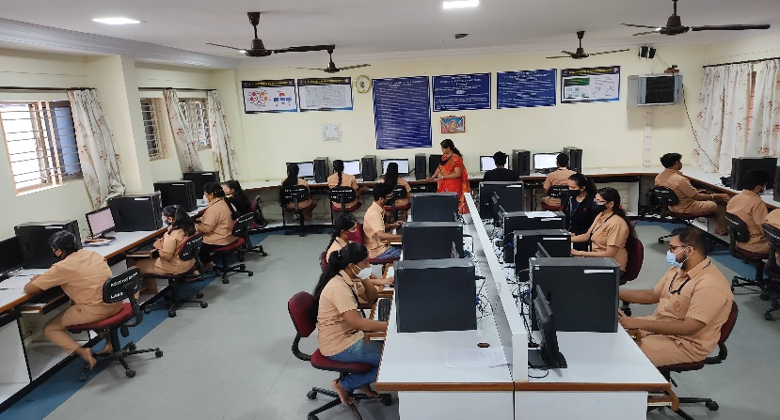
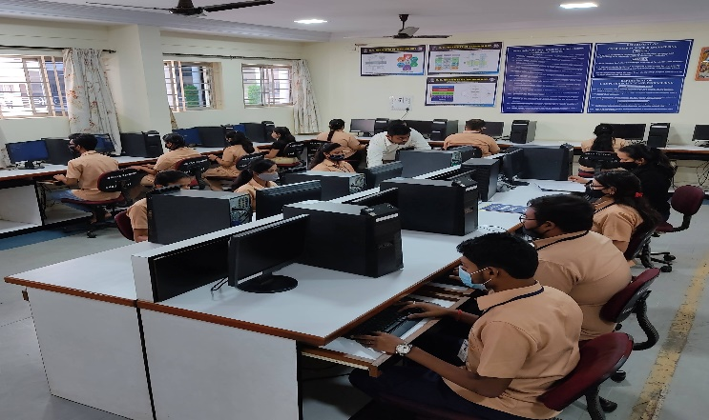
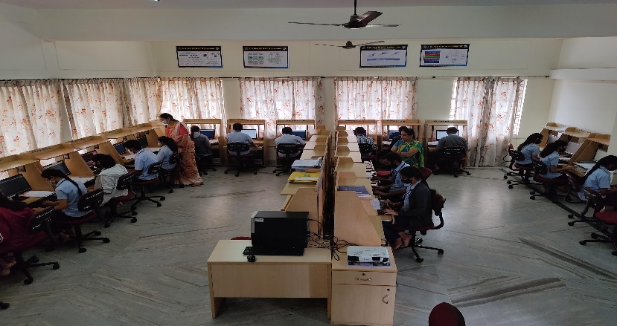
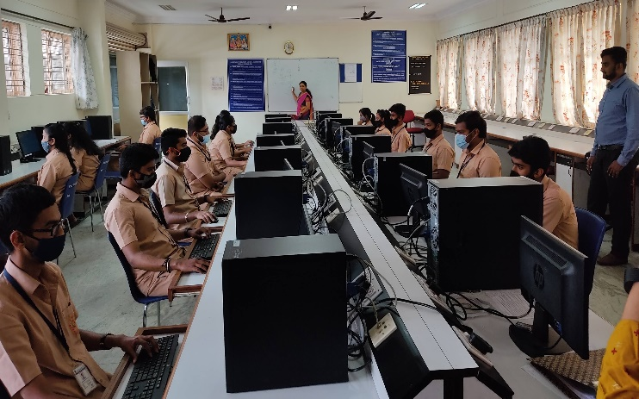
Facilities –Laboratories
Laboratory Name and Photo | Laboratory Name and Photo
Machine Learning Laboratory and DBMS Laboratory/Project Work | Computer Network Laboratory/Project Work
Data Structures Laboratory / Design And Analysis of Algorithm Laboratory and System Software and Operating System Laboratory | Web Technology Laboratory / DBMS Laboratory/ Computer graphics Laboratory

Slide 41
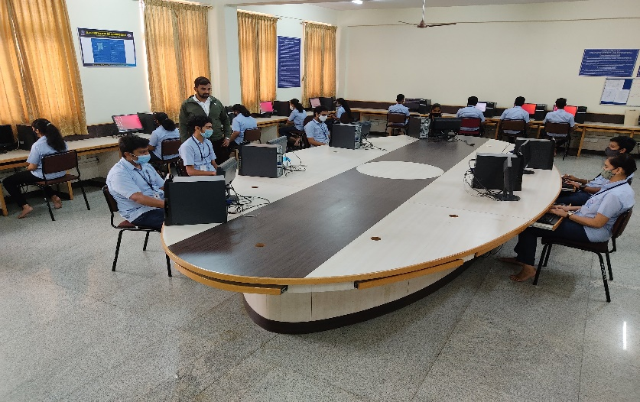
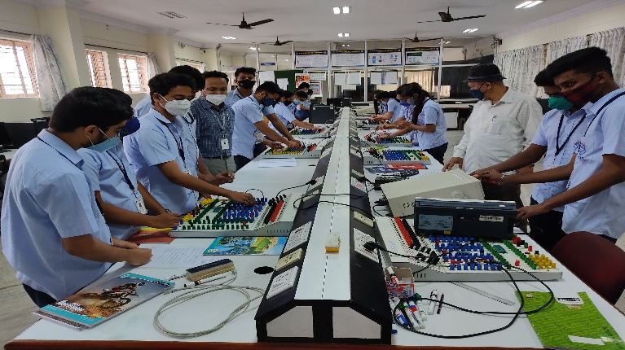
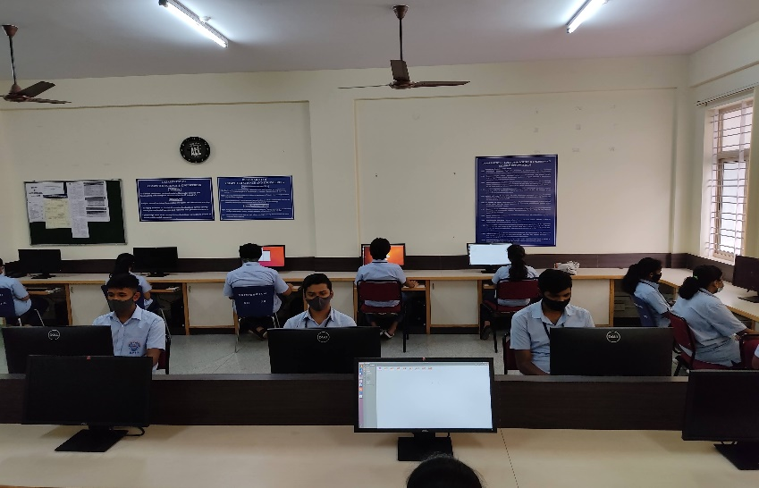
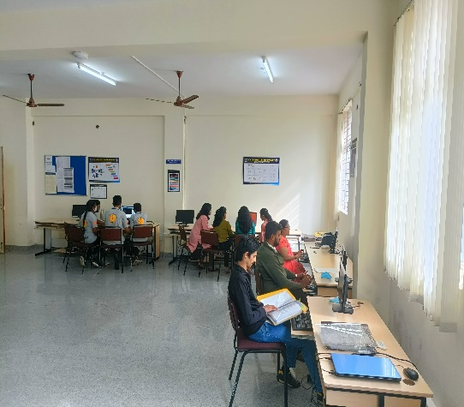
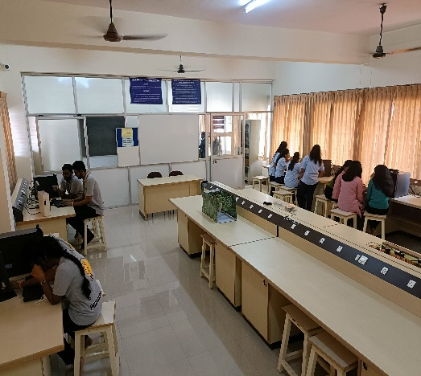
Facilities –Laboratories
Laboratory Name and Photo | Laboratory Name and Photo
Analog And Digital Electronics Laboratory / Microcontroller and embedded system Laboratory/ System Software and Operating System Laboratory | Computer Programming Laboratory
Mobile Application Development Laboratory | R and D Project work Laboratory

Slide 42
Licensed Software Details
Sl. No | Item/ Equipment | Date of Renewal | Total Cost
1 | Windows OS (173 Central utilization) -Windows 8.1, professional, Windows 7, Professional 10, Windows server standard 2012 R2 | Permanent | 9.31Lac
2 | DEL SONIC WALL -NSC 3600 (1000 users Central utilization) | 17/01/ 2023 | 3.62Lac
3 | Quick Heel (10 users Central utilization) | 2/6/2023 | Rs.10,595
4 | Office 2016 (5 user) | Permanent | Rs.18,000
5 | Office 2013 (10 user) | Permanent | Rs. 27,000

Slide 43
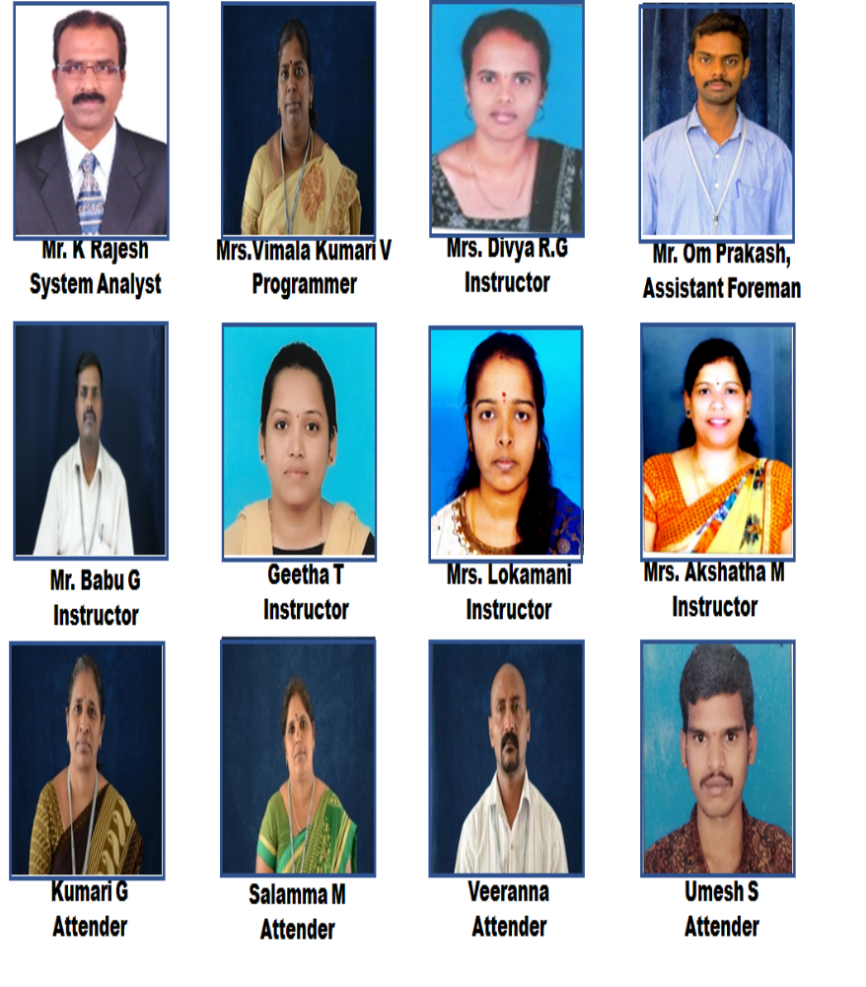
Technical and Supporting staff
Sl.No | Name | Qualification | Designation
1 | K Rajesh | MCA | System Analyst
2 | Mrs.Vimala Kumari V | M. Sc in CSE | Programmer
3 | Mrs. Divya R.G | BCA, Diploma in CSE | Instructor
4 | Mr. Om Prakash | Diploma in Electrical | Assistant Foreman
5 | Mr. Babu G | Diploma in CSE | Instructor
6 | Geetha T | B. E in CSE, Diploma in CSE | Instructor
7 | Mrs. Lokamani | B. E in E&C Diploma in E&C | Instructor
8 | Mrs. Akshatha M | Diploma in E&C | Instructor
9 | Kumari G | Attender | S.S.L.C.
10 | Salamma M | Attender | S.S.L.C.
11 | Veeranna | Attender | S.S.L.C.
12 | Umesh S | Attender | 8th Std

Slide 44
Criteria-7 Continuous Improvement
POs Attainment Levels and Actions for Improvement
POs | Target Level | Attainment Level | Observation
PO4 | CONDUCT INVESTIGATIONS OF COMPLEX PROBLEMS
 | 1.9 | 1.90 | 1. Target is attained. 2. It is proposed to increase the Target Level in the next academic year.
Action 1 | Android Application Development workshop were conducted.
Action 2 | Students were motivated to take participation in national and international conferences.
POs | Target Level | Attainment Level | Observation
PO12 | LIFE-LONG LEARNING
 | 1.8 | 1.69 | Target is NOT attained.
Action 1 | Technical Talk on Internet of Things was organized.
Action 2 | Students were encouraged to register and complete online courses from Coursera, Sololeam, Udemy, Verzeo and NPTEL.

Slide 45
Audit Levels and Responsibilities
Faculty Level Process
HOD
DAC
Module
Coordinator
Preparation and Maintenance of Course File by improvising COs, COs-POs and COs-PSOs mapping
CIA assessment, identification of weak and bright students on the basis of performance of student, assignment preparation & Preparation of Closing Report
PAC
Internal Audit
Verification of course files and personal file of all the faculties
Overall Program Level Improvement
Checking and coverage of COs in question papers
Monitoring quality of CIE papers and assignments
Submission of Audit Report
External Audit
Sample course file, student attendance record, sample blue books, Minutes of class committee meetings, student mentor process, faculty feedback, result analysis file, internal audit proofs
Reporting on verification
Analysis of PO attainment and preparation of action plan
Course Coverage, Attendance monitoring, Physical verification of Classes and Labs, etc

Slide 46
Progress of the Program
Statistics of Average Package Offered
Year | 2020-21 | 2019-20 | 2018-19 | 2017-18 | 2016-17
Total number of students | 101 | 110 | 117 | 115 | 140
Total Number of Placed students | 88 | 87 | 76 | 57 | 64
Highest Package Offered in Lac | 18 | 7 | 7 | 7 | 5.15
Lowest Package per annum in Lac | 2.14 | 2.5 | 2 | 1.50 | 1.05
Average Package Offered in Lac | 4.16 | 3.58 | 4.29 | 3.08 | 3.10
Statistics of Visited Companies
Year | 2020-21 | 2019-20 | 2018-19 | 2017-18 | 2016-17
No. of Companies Visited | 44 | 18 | 25 | 23 | 20

Slide 47
Outcome Based Education(OBE)
Framework for Outcome Based Education
Institute Vision and Mission
Program Outcomes
Washington Accord
Teaching Learning & Evaluation
Department Vision and Mission
Course Outcomes
Program
Program Educational Objectives
Graduate Engineer

Slide 48
Outcome Based Education(OBE)
Outcomes based education (OBE) is a process that involves the restructuring of curriculum, assessment and reporting practices in education to reflect the achievement of high order learning and mastery rather than the accumulation of course credits
  Benefits of OBE:
  More directed & coherent curriculum.
  Graduates will be more “relevant” to industry & other stakeholders (more well rounded graduates)
  Continuous Quality Improvement (CQI) is in place.

Slide 49
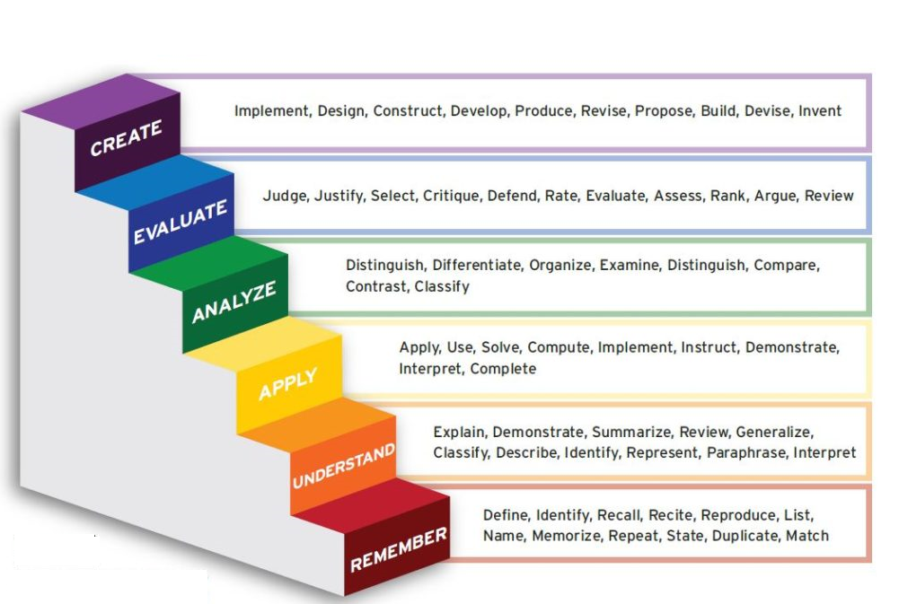
New Blooms Taxonomy

Slide 50
Outcome Based Education(OBE)
Students Under OBE
Students are expected to be able to do more challenging tasks other than memorize and reproduce what was taught.
Students should be able to: write project proposals, complete projects, analyze case studies, give case presentations, show their abilities to think, question, research, and make decisions based on the findings.
Be more Creative, able to analyze and Synthesize information.
Able to plan and organize tasks, able to work in team as a community to propose solutions to problems and market their solutions

Slide 51
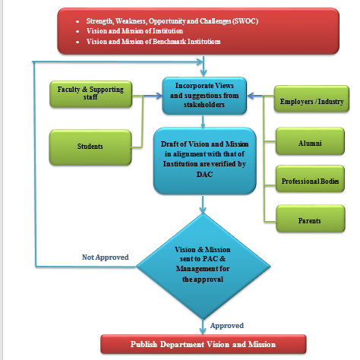
Process for defining Vision and Mission statements

Slide 52
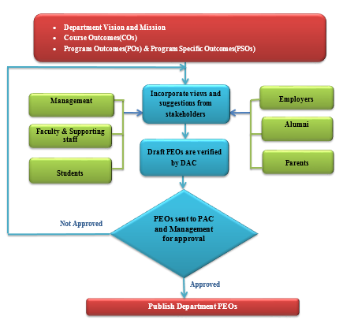
Process for defining
Program Educational Objectives (PEOs)

Slide 53
Process to Improvise Course Outcomes
CO improvisation (if any) by Course Coordinators based on specific approach planned to handle the course
Bloom’s Taxonomy
University syllabus
PSO
Refined CO’s will be checked & scrutinized by the module coordinators
Updating of CO’s
If recommended
No
Yes
Approved by HOD
Freezing & Adopting by Course Owner

Slide 54
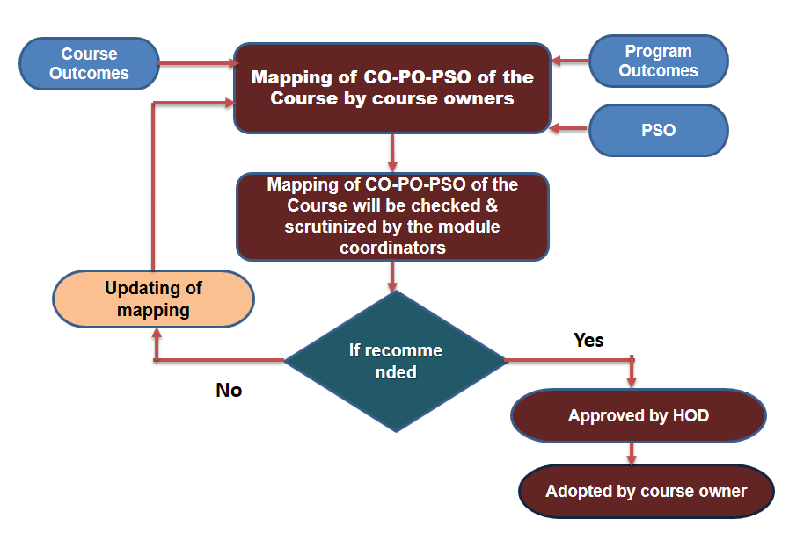
Process for CO-PO & CO-PSO Mapping

Slide 55
Process for
identification of
Curriculum Gaps
University Curriculum
Before commencement of a batch
CO-PO/PSO mapping is done for the
courses & kept for Department Reference
Consolidated CO-PO Mapping table for courses (N) is prepared & documented.
T=Courses addressing PO/PSO
A= Summation of Mapping strength
University curriculum is substantial to address the said PO/PSO
Yes
For a given PO/PSO
T≥8 &
A≥24
NO
% of curriculum gap (G) is calculated for PO/PSO
Department takes initiatives to bridge the gap by conducting events like workshops, seminars etc.

Slide 56
Policies followed In Teaching learning Process
K.S Institute of Technology is affiliated to VTU
For affiliated institution Scheme & Syllabus will be framed by BOS in VTU & will be published in VTU website
Faculty are given freedom to review & refine the Course Outcomes
The refined course outcomes along with mapping of course outcomes with PO’s will be checked & scrutinized by the module coordinators
Faculty will highlight the gaps obtained after mapping CO’s & PO’s for the course allotted along with pedagogy activities to minimize gaps
Consolidated CO PO mapping for all the courses will be used for finding the gap for a particular batch
Department level events will be planned to improve the conceptual & experimental learning for minimizing the gaps
Attainment is calculated for all courses considering SEE & CIE[Direct attainment] and attainments from events [indirect]

Slide 57
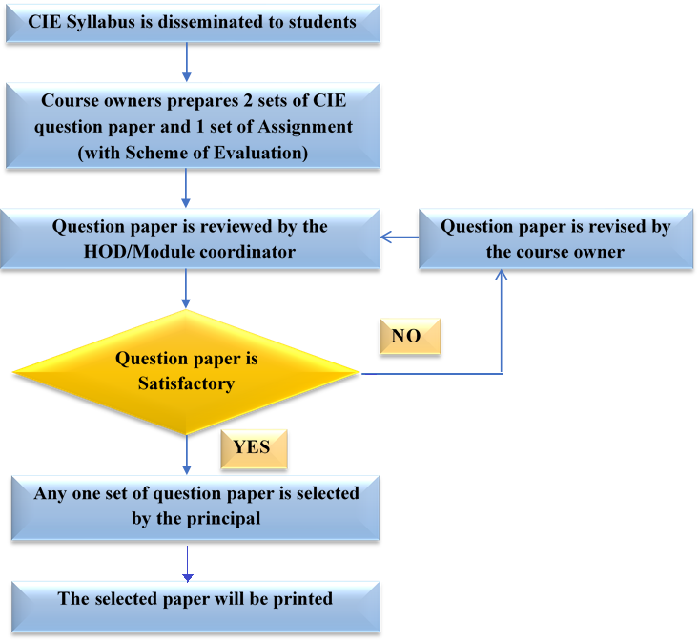
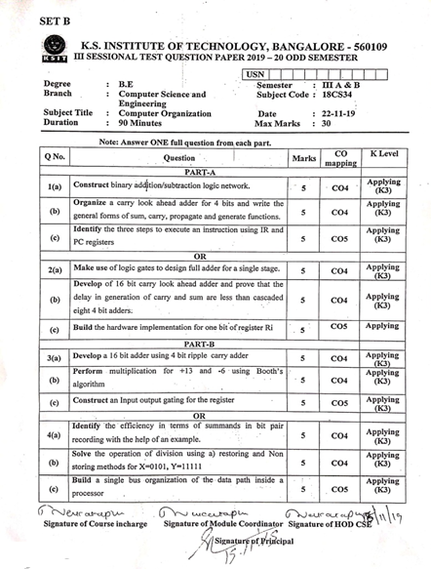
Quality of internal Assessment Question papers
IA QP 2019-20 Even semester

Slide 58
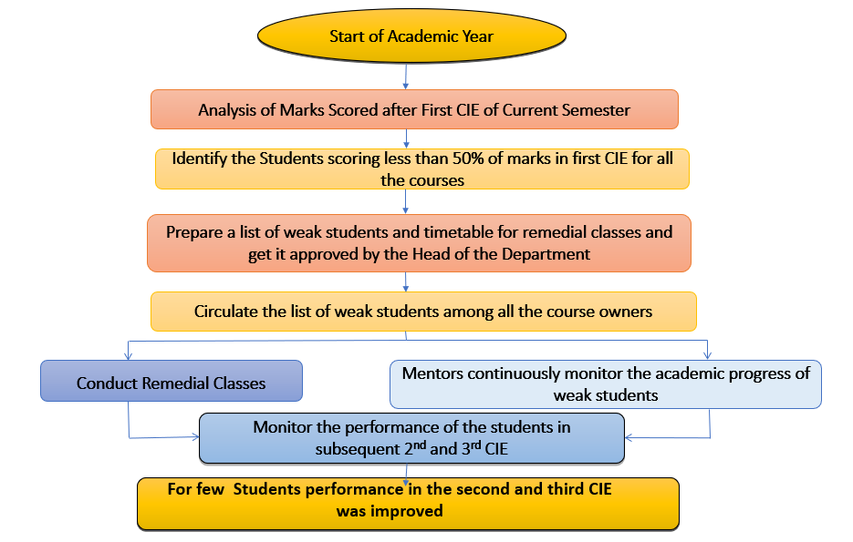
Process to Identify and Support weak students

Slide 59
Process to Identify
and encourage bright students
Conduction of 1st CIE
Analysis of the marks scored after 1st CIE
Course Owners Prepares a list of students who have scored more than 50% of the marks in 1stCIE and identify them as Bright students
Encouraged to aim for Academic Excellence
Students are encouraged to participate in various coding competitions (Hackathons) and are guided to publish technical papers
Top two students from each class are identified and suitably awarded with certificates, cash prize at Institute level

Slide 60
Area of specialization of the faculty is shared with students
Identification of projects, allocation methodology and Evaluation
Students are informed to form the project groups, select the project title and preference of guides based on domain and guide’s expertise
Guides are allotted to batches & abstract is submitted to the Project coordinator
Students are informed to refine the project topic & resubmit the abstract
In 0th review project idea is presented, approved ?
No
Yes
Project progress is monitored &
evaluated further in 3 reviews
by Guide and evaluators
Consolidated marks is sent to University after the approval from the HoD & Principal

Slide 61
Assessment Tools used for CO Attainment Calculation

Slide 62
Faculty Performance Appraisal and Development System (FPADS)
Faculty fills & submits the appraisal form for academic year
HOD reviews the self-appraisal forms & discusses and forwards the same to the Head of the Institution for comments
Head of the institution writes the remarks & forwards to further review to committee
Committee members comprising of chairman, AAB, Principal & HOD will evaluate and write review comments
Overall performance Rating
< 80%
Results obtained is 100%
Committee recommends required action (if any)
Advised to improve
Certificate of Appreciation
HOD Suggests action plan to the faculty member

Slide 63
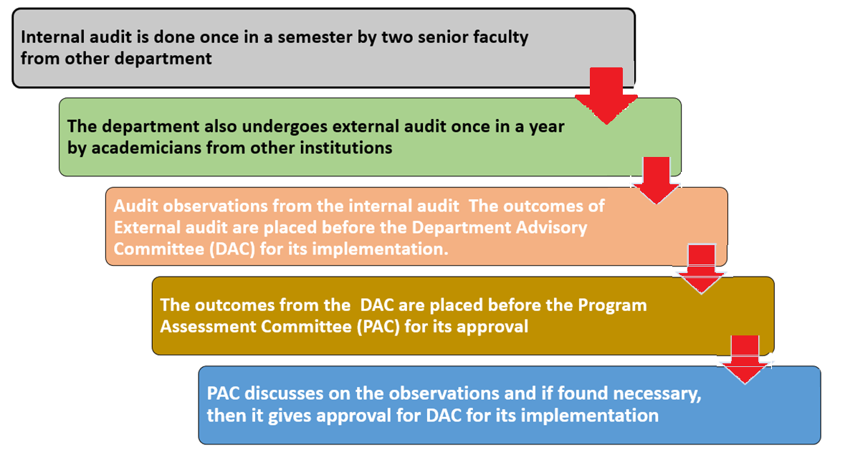
Academic Audit Conduct Mechanism

Slide 64
Internal/External Academic Audit Process
Verification of
Sample Course File
Students Attendance Record
Sample Blue Book
Faculty Feed back
Result Analysis File
Mentoring process
Class committee details
Internal Audit Proof
Verification of
Course Files
Personal Files
External Audit
Internal Audit
Outcomes of Audit
Department Advisory Committee (DAC)
Audit observations for Approval
Approval for Implementation
Program Assessment Committee (PAC)

Slide 65
Conclusion
OBE is student centric and Improved learning process.
It will enhance the learning opportunities for teachers that reinforce and expand their knowledge
Increased institutional effectiveness
Enhanced accountability in Teaching and Learning process
Quality education
Development is measurable & linked
  Program outcomes /course outcomes
  Program Educational Objectives
  Assessment & Evaluation
Teachers' Learning will be a valuable resource for classrooms, Departments, and professional organizations.

Slide 66
THANK YOU

